Slide 1
Trial 1 Press any key to continue.

Slide 2
+

Slide 3
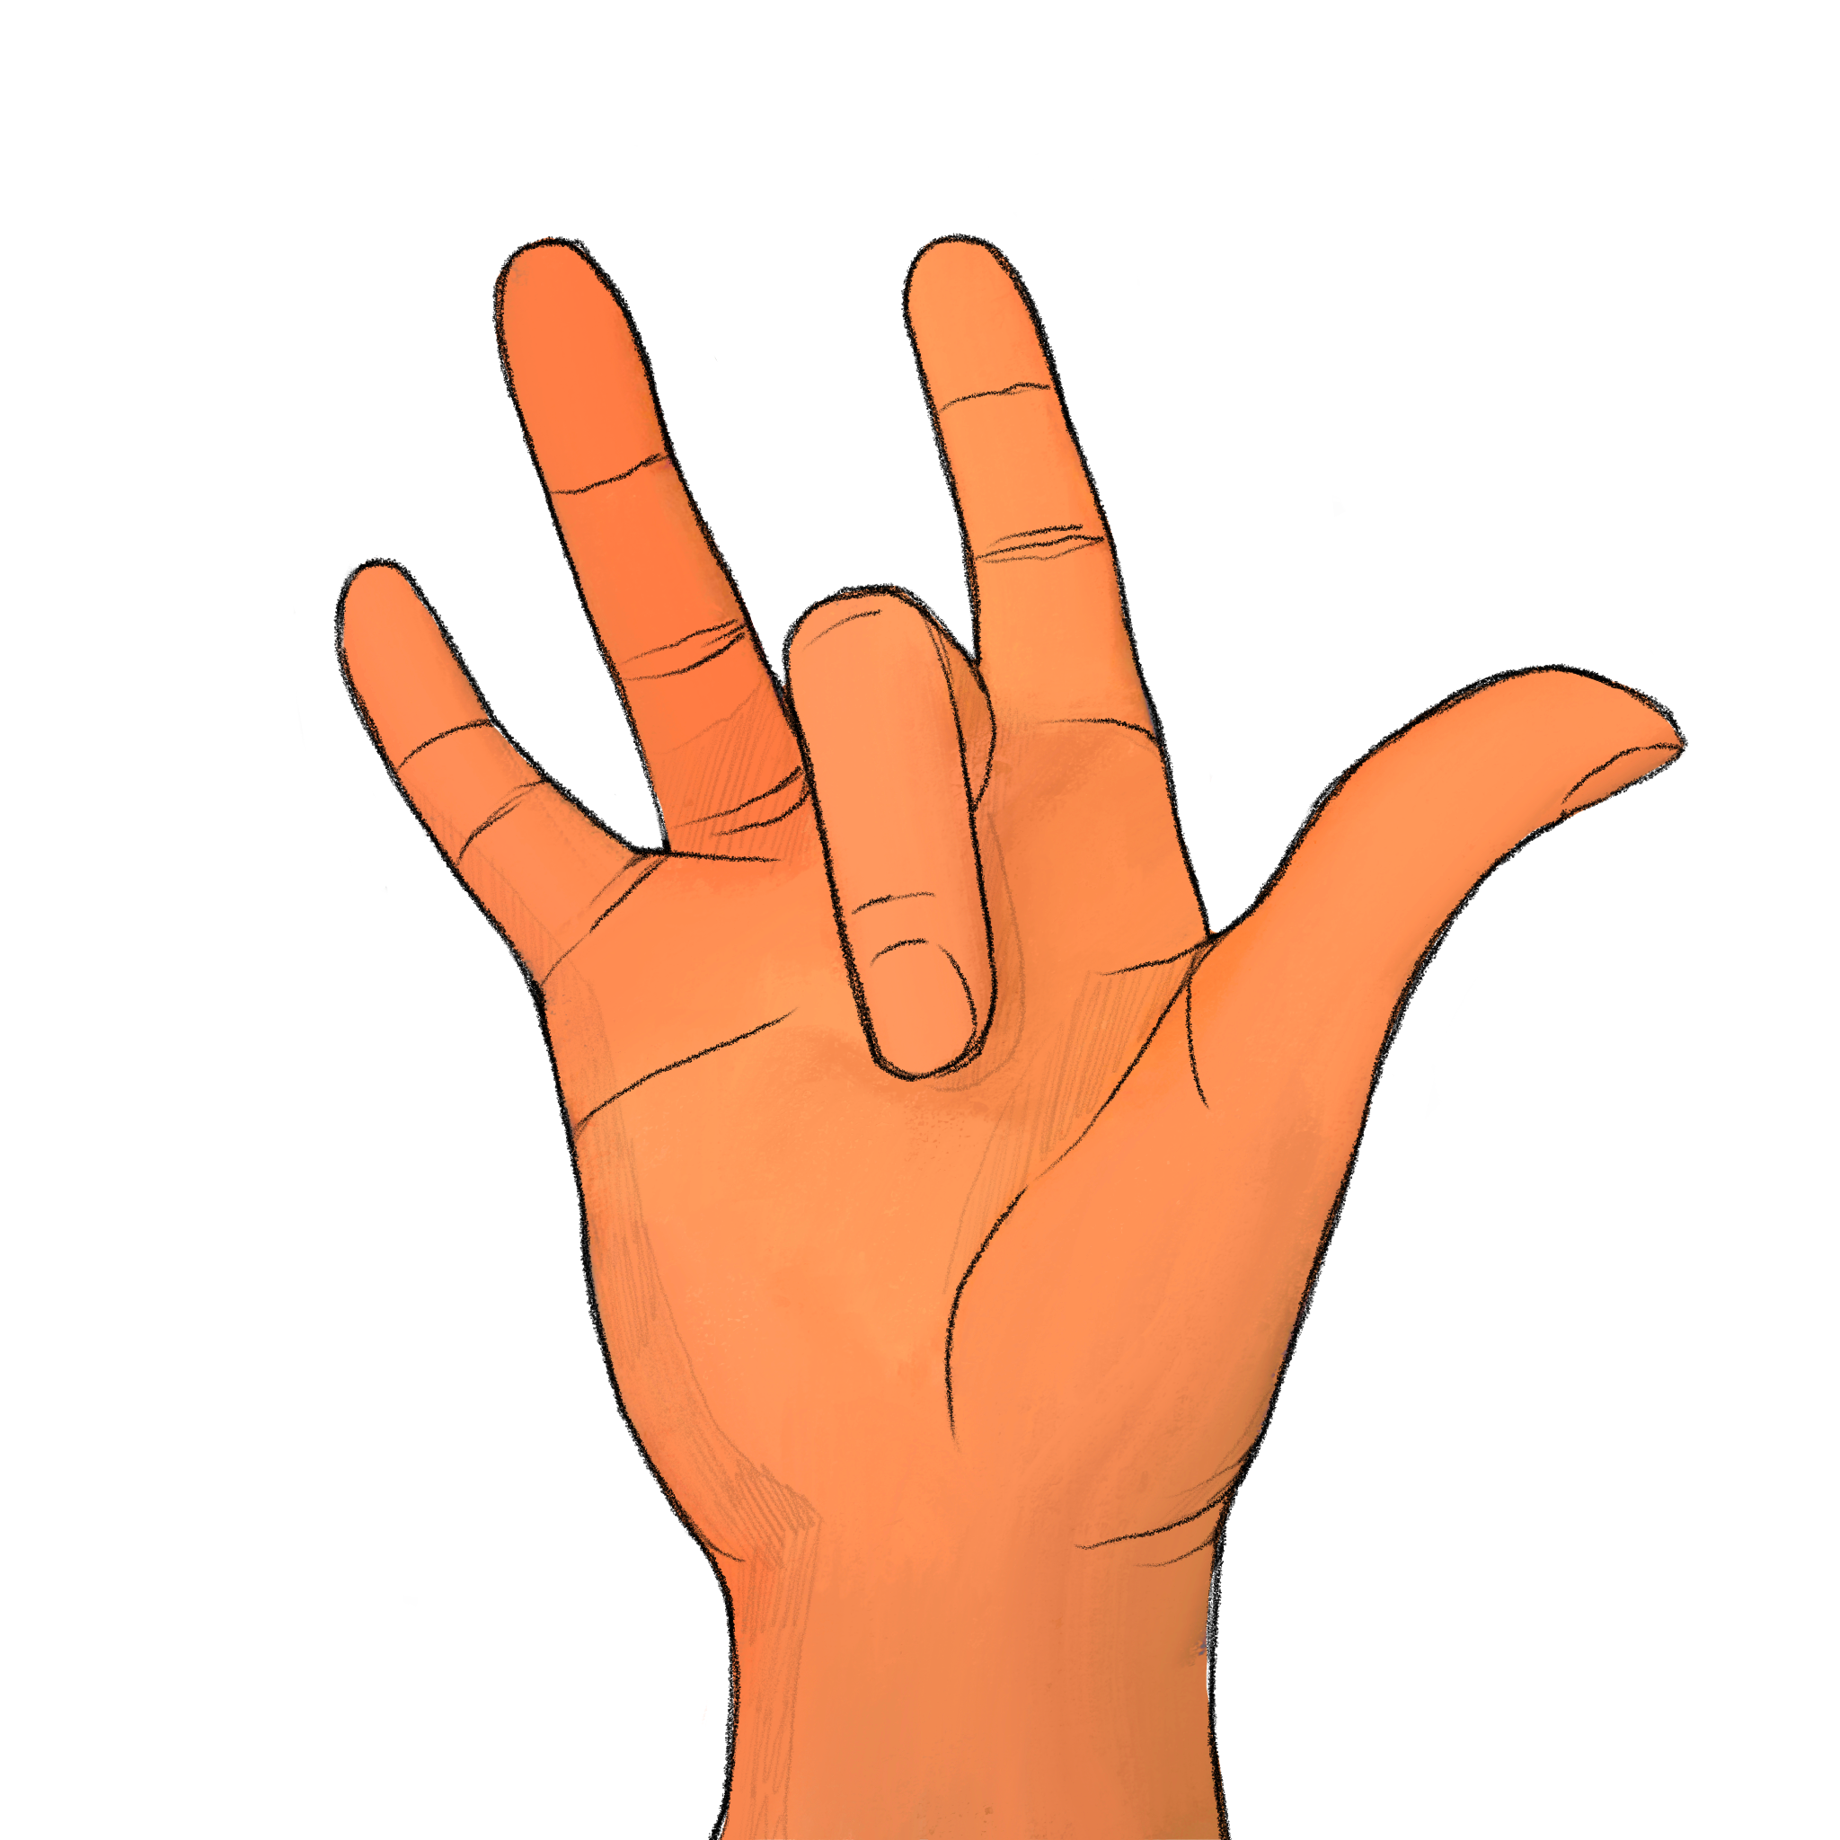
+

Slide 4
How many digits were raised? Experimenter, record the participant’s response if given before next slide transition; otherwise record a ’timeout’

Slide 5
Trial 2 Press any key to continue.

Slide 6
+

Slide 7
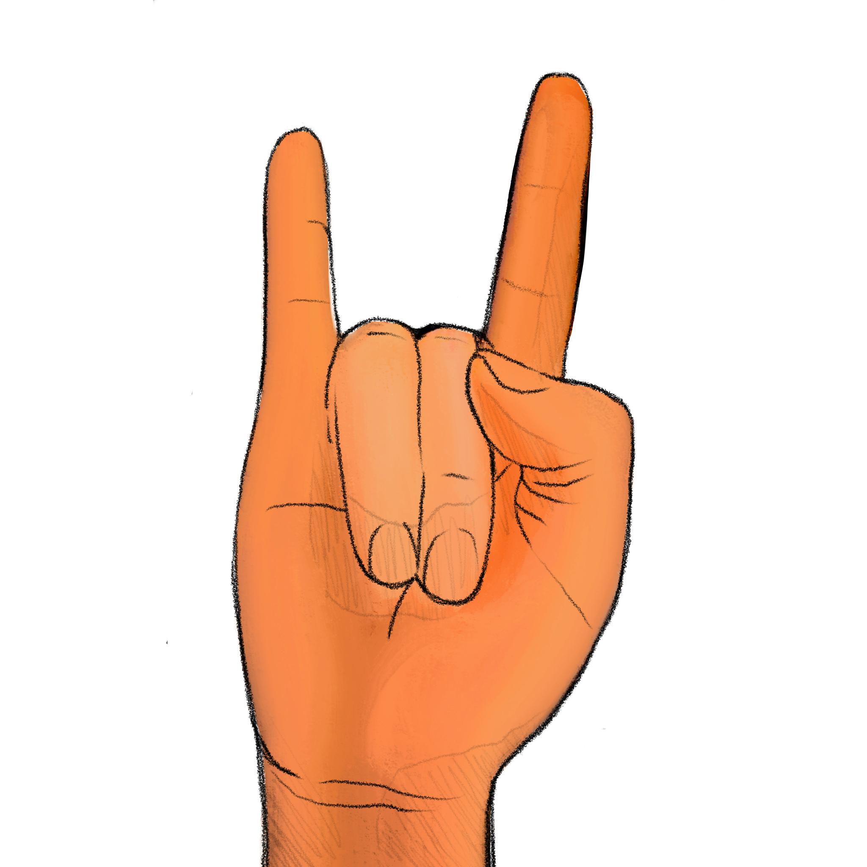
+

Slide 8
How many digits were raised? Experimenter, record the participant’s response if given before next slide transition; otherwise record a ’timeout’

Slide 9
Trial 3 Press any key to continue.

Slide 10
+

Slide 11
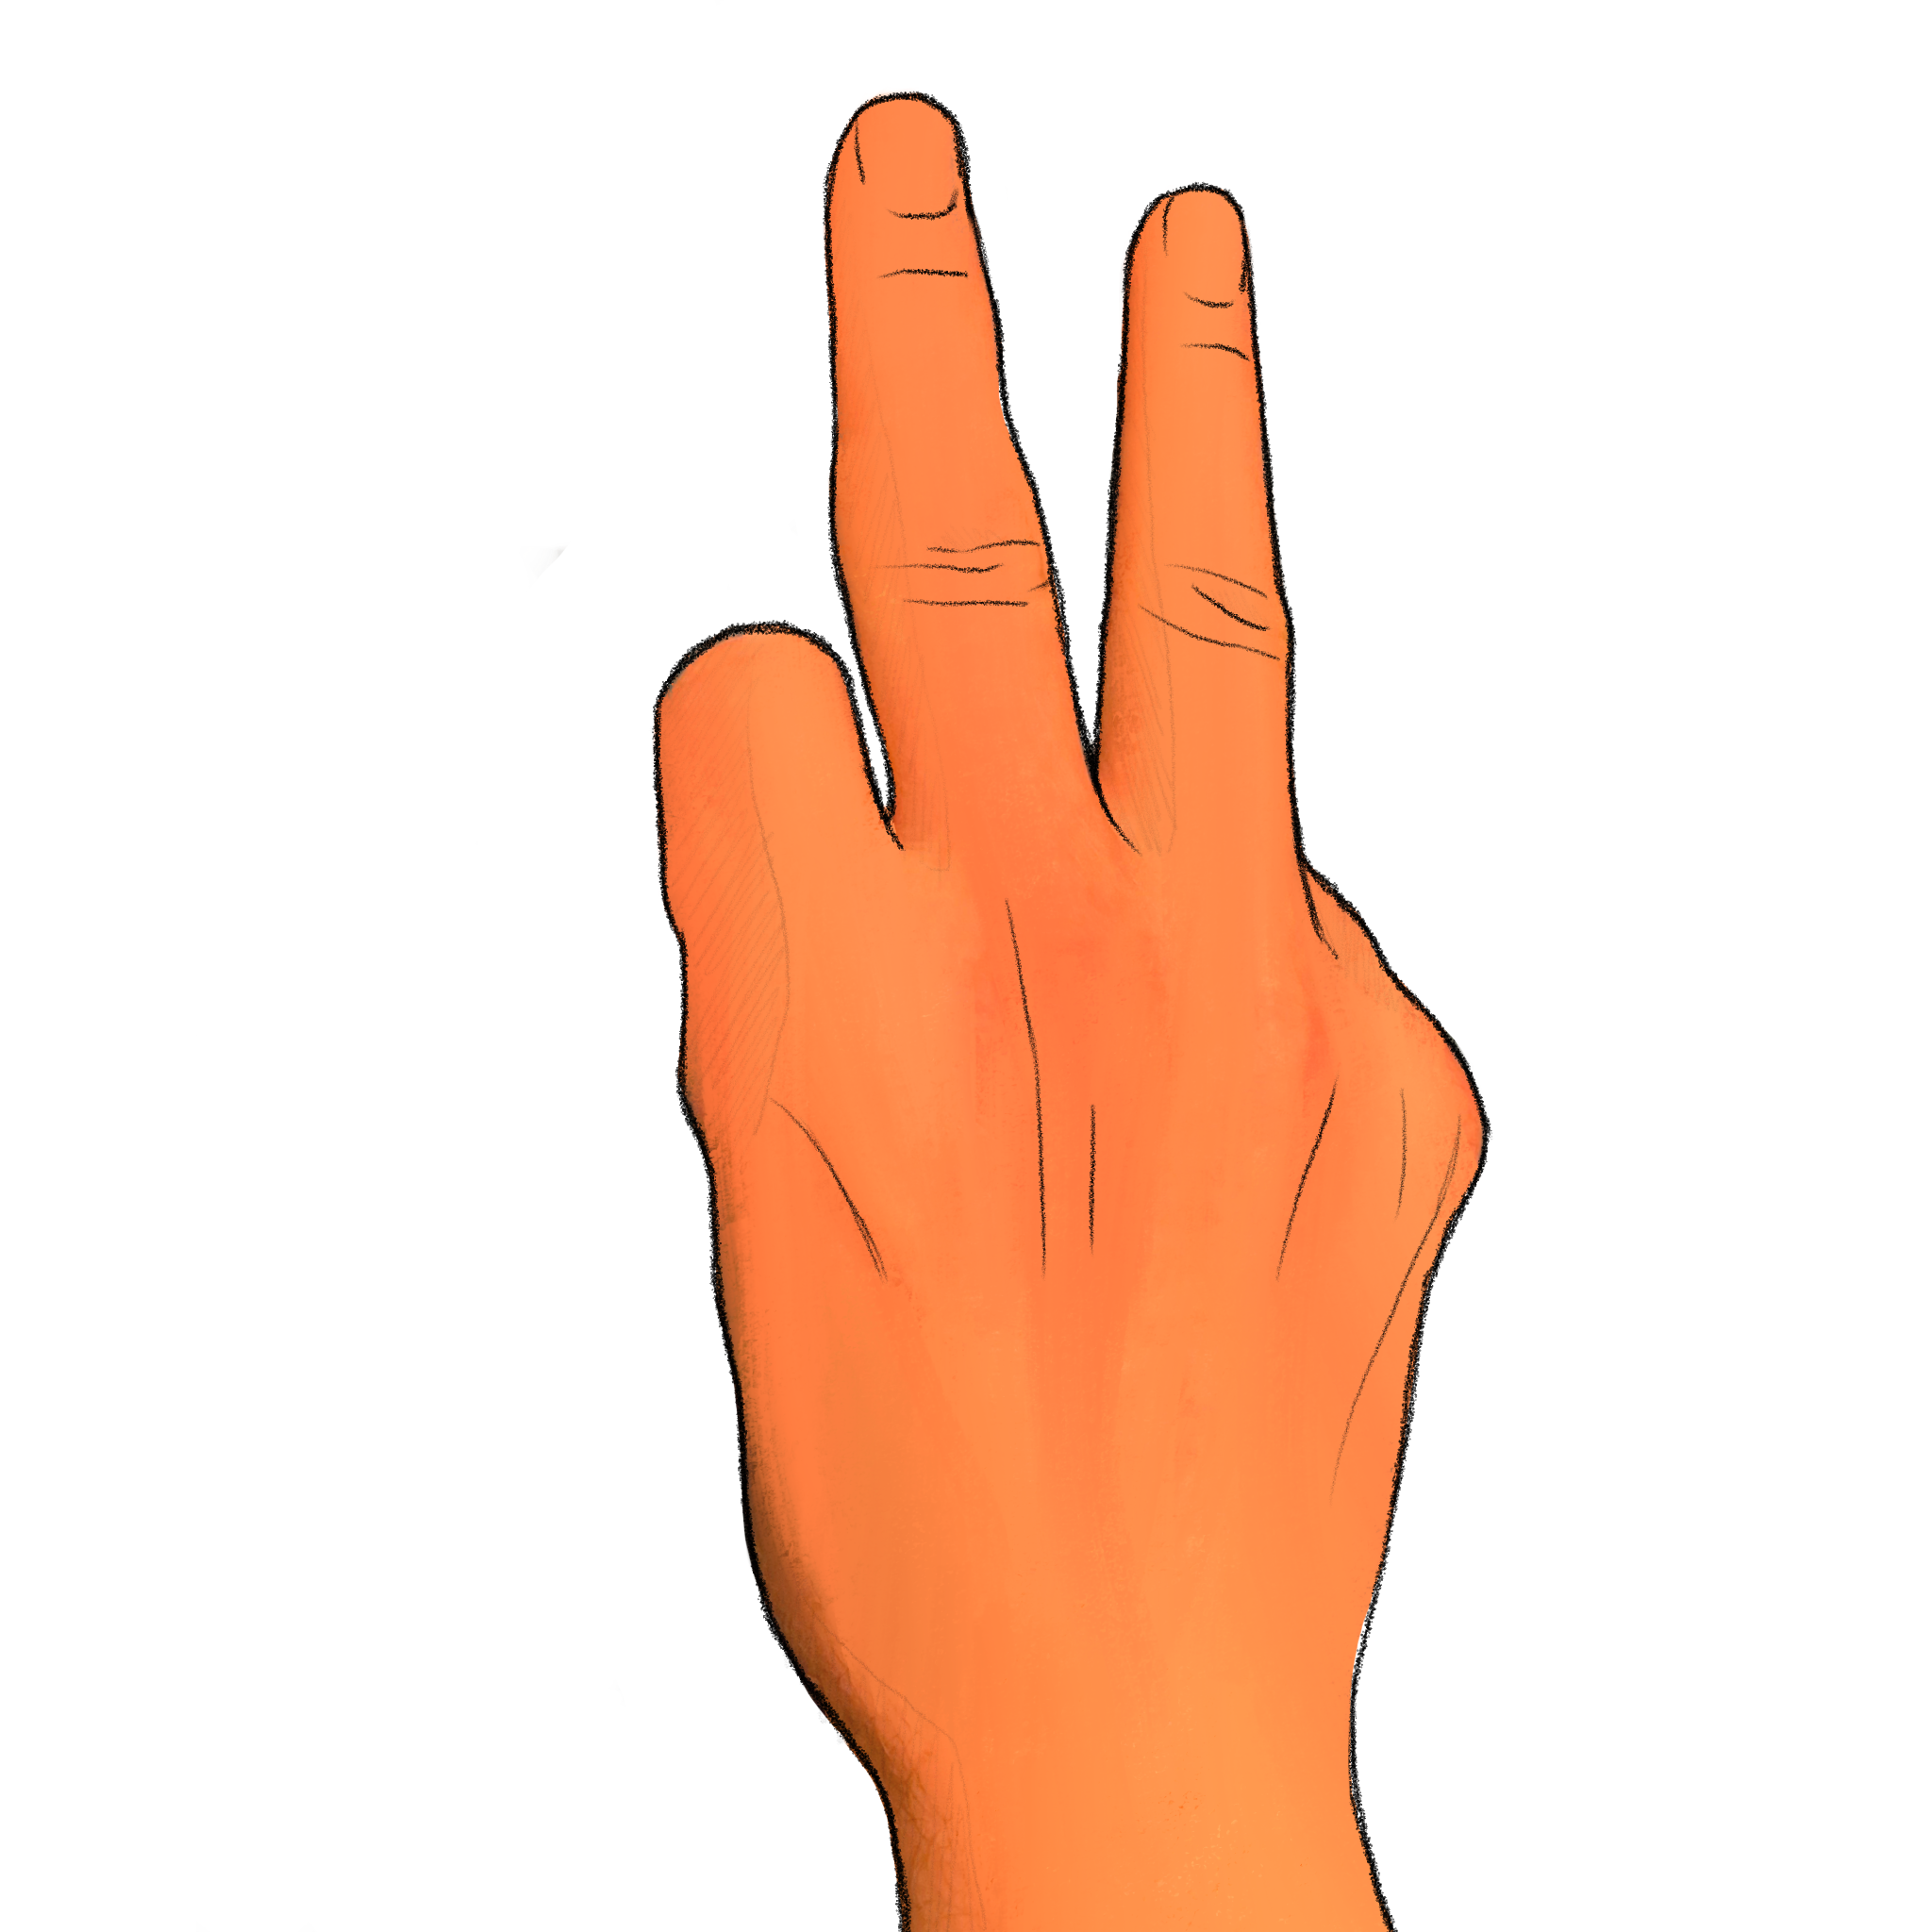
+

Slide 12
How many digits were raised? Experimenter, record the participant’s response if given before next slide transition; otherwise record a ’timeout’

Slide 13
Trial 4 Press any key to continue.

Slide 14
+

Slide 15
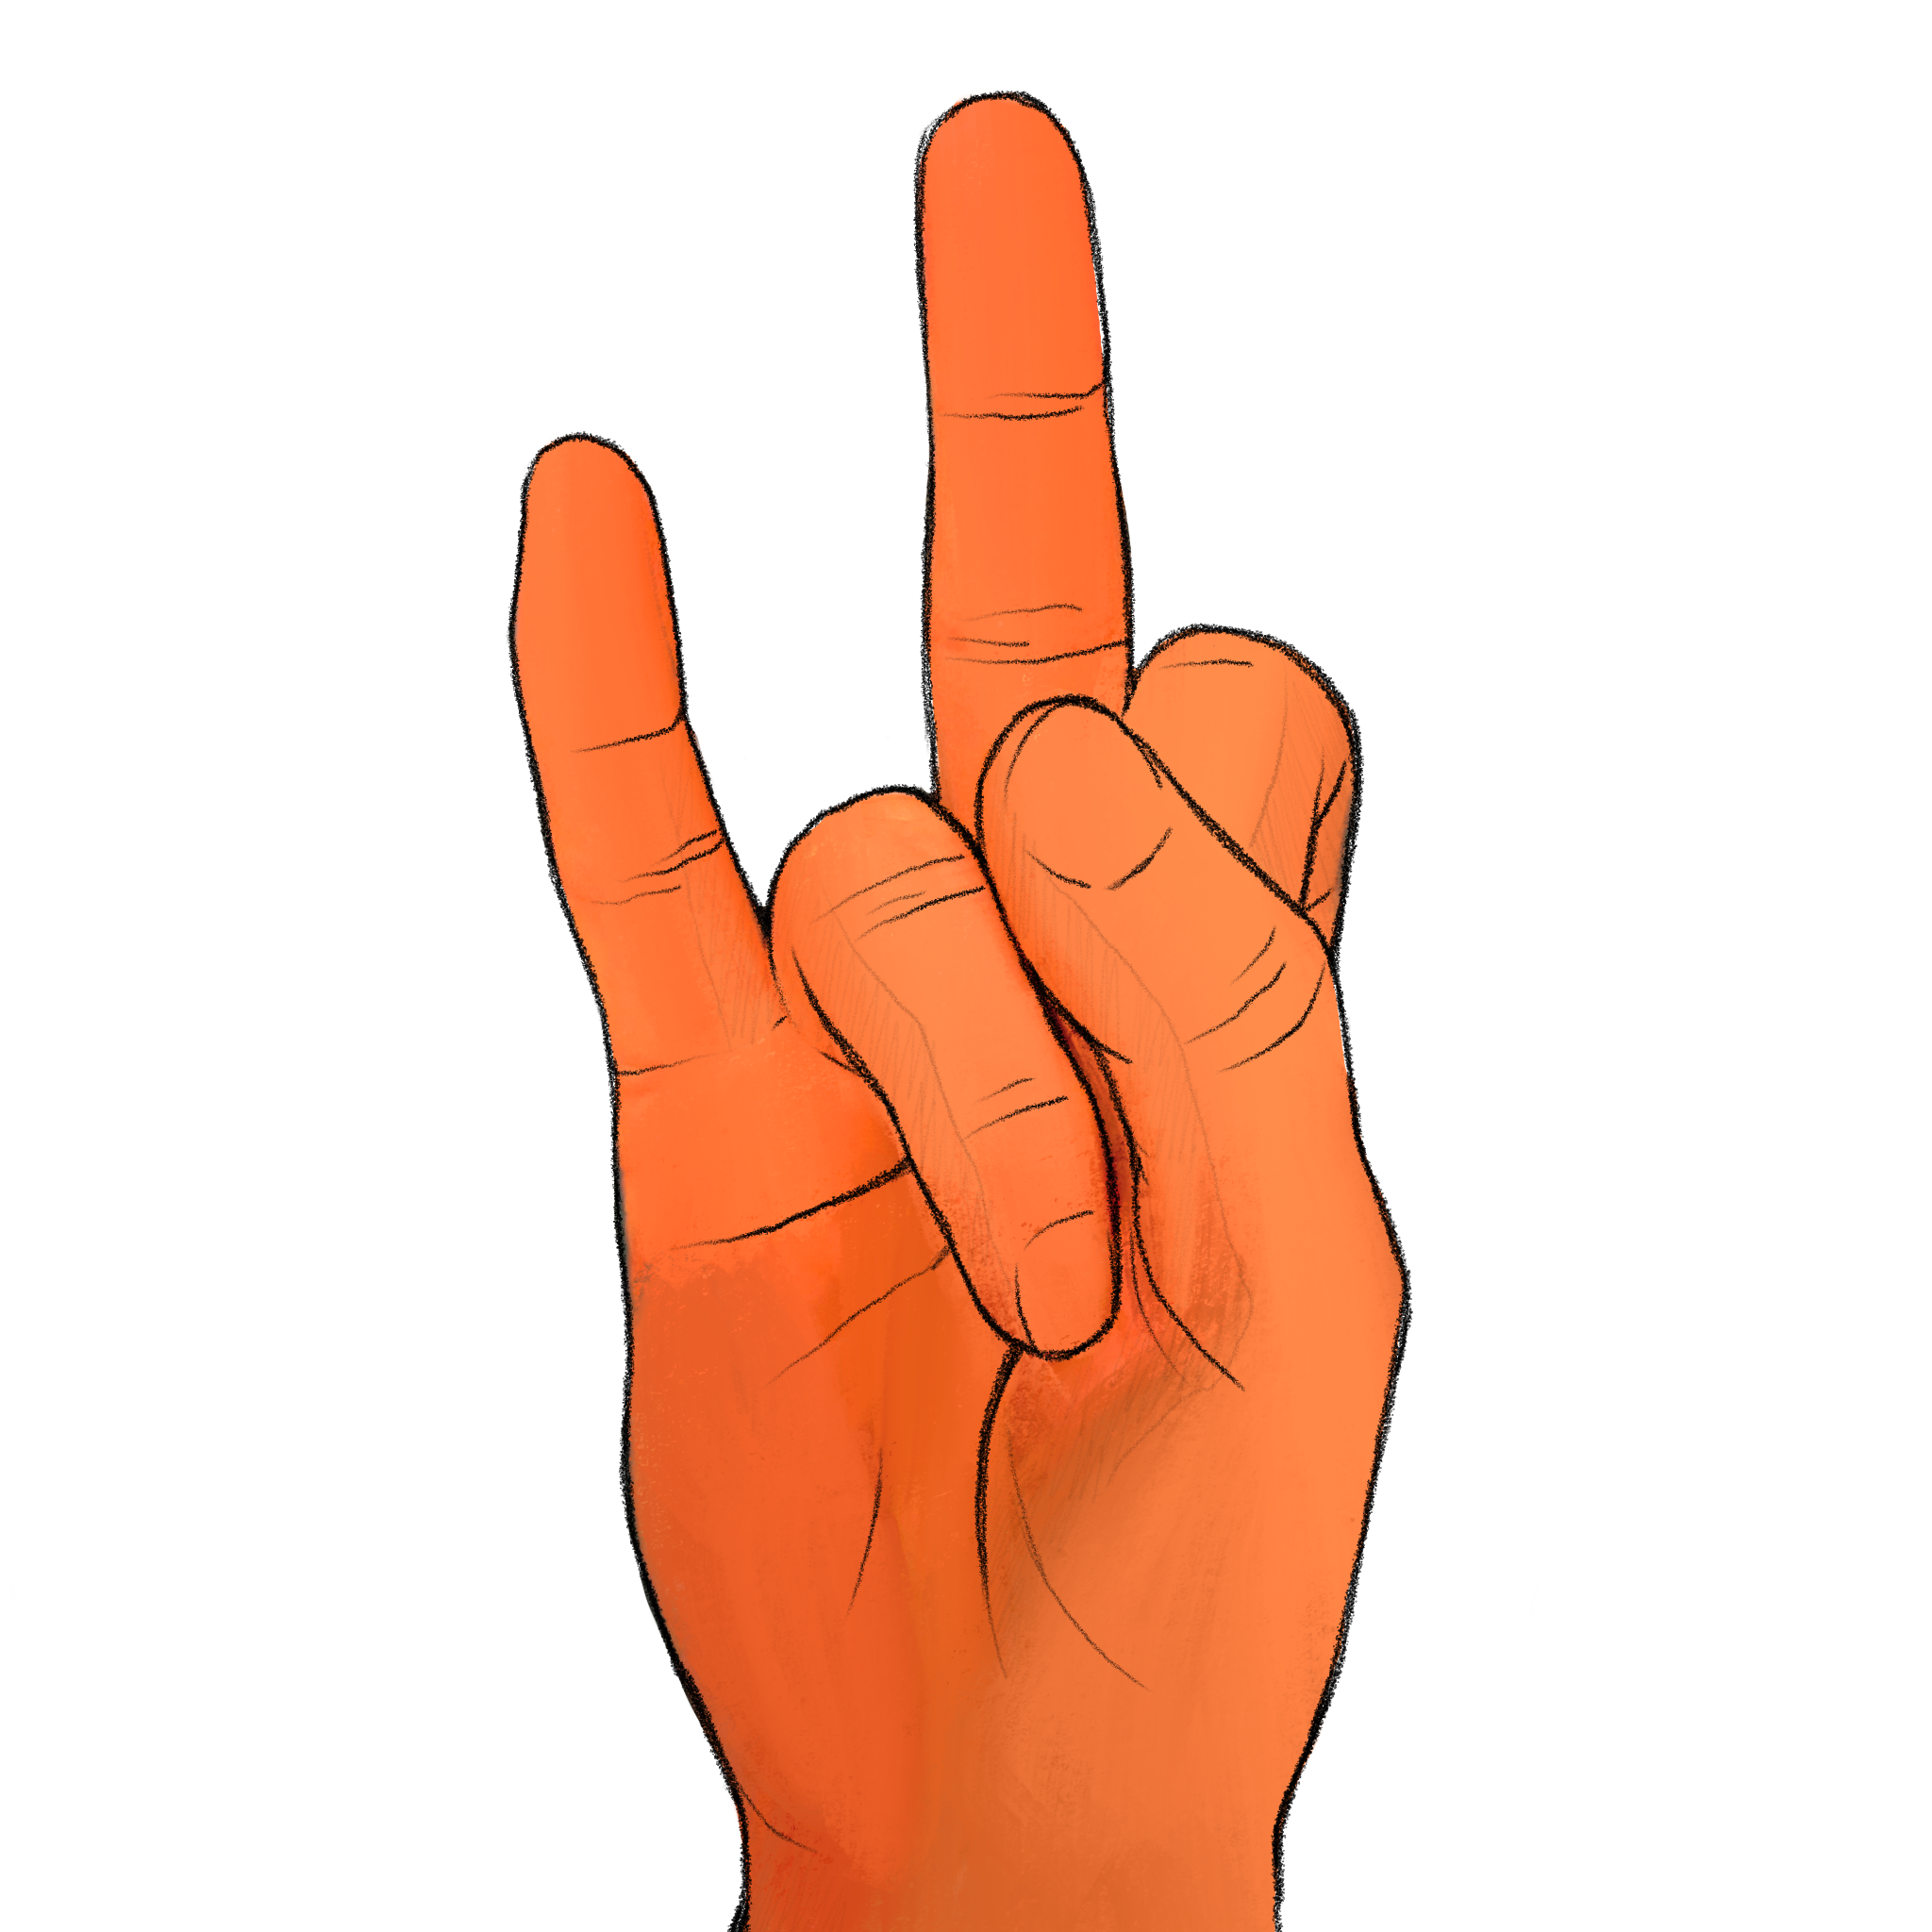
+

Slide 16
How many digits were raised? Experimenter, record the participant’s response if given before next slide transition; otherwise record a ’timeout’

Slide 17
Trial 5 Press any key to continue.

Slide 18
+

Slide 19
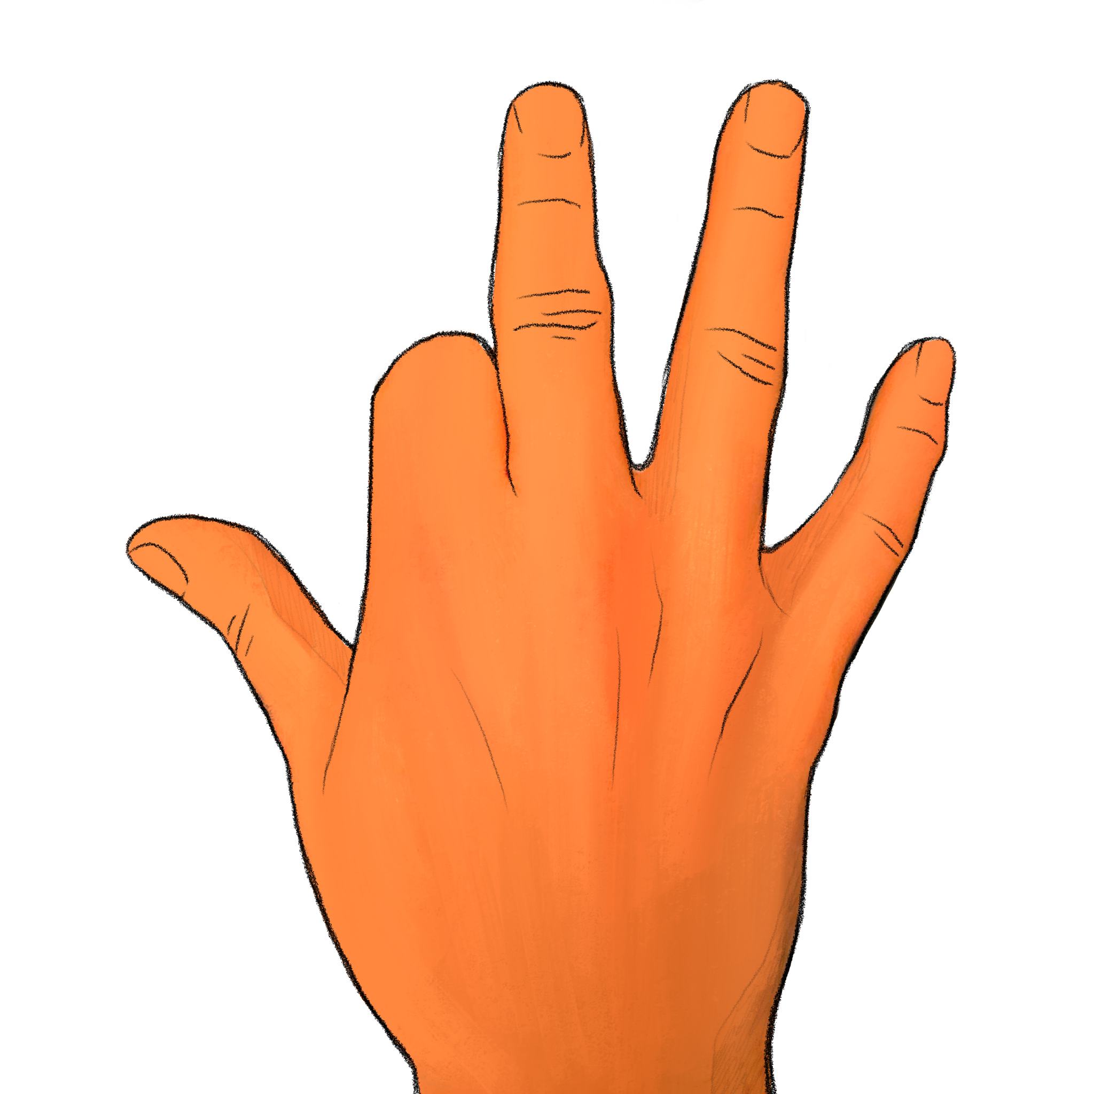
+

Slide 20
How many digits were raised? Experimenter, record the participant’s response if given before next slide transition; otherwise record a ’timeout’

Slide 21
Trial 6 Press any key to continue.

Slide 22
+

Slide 23
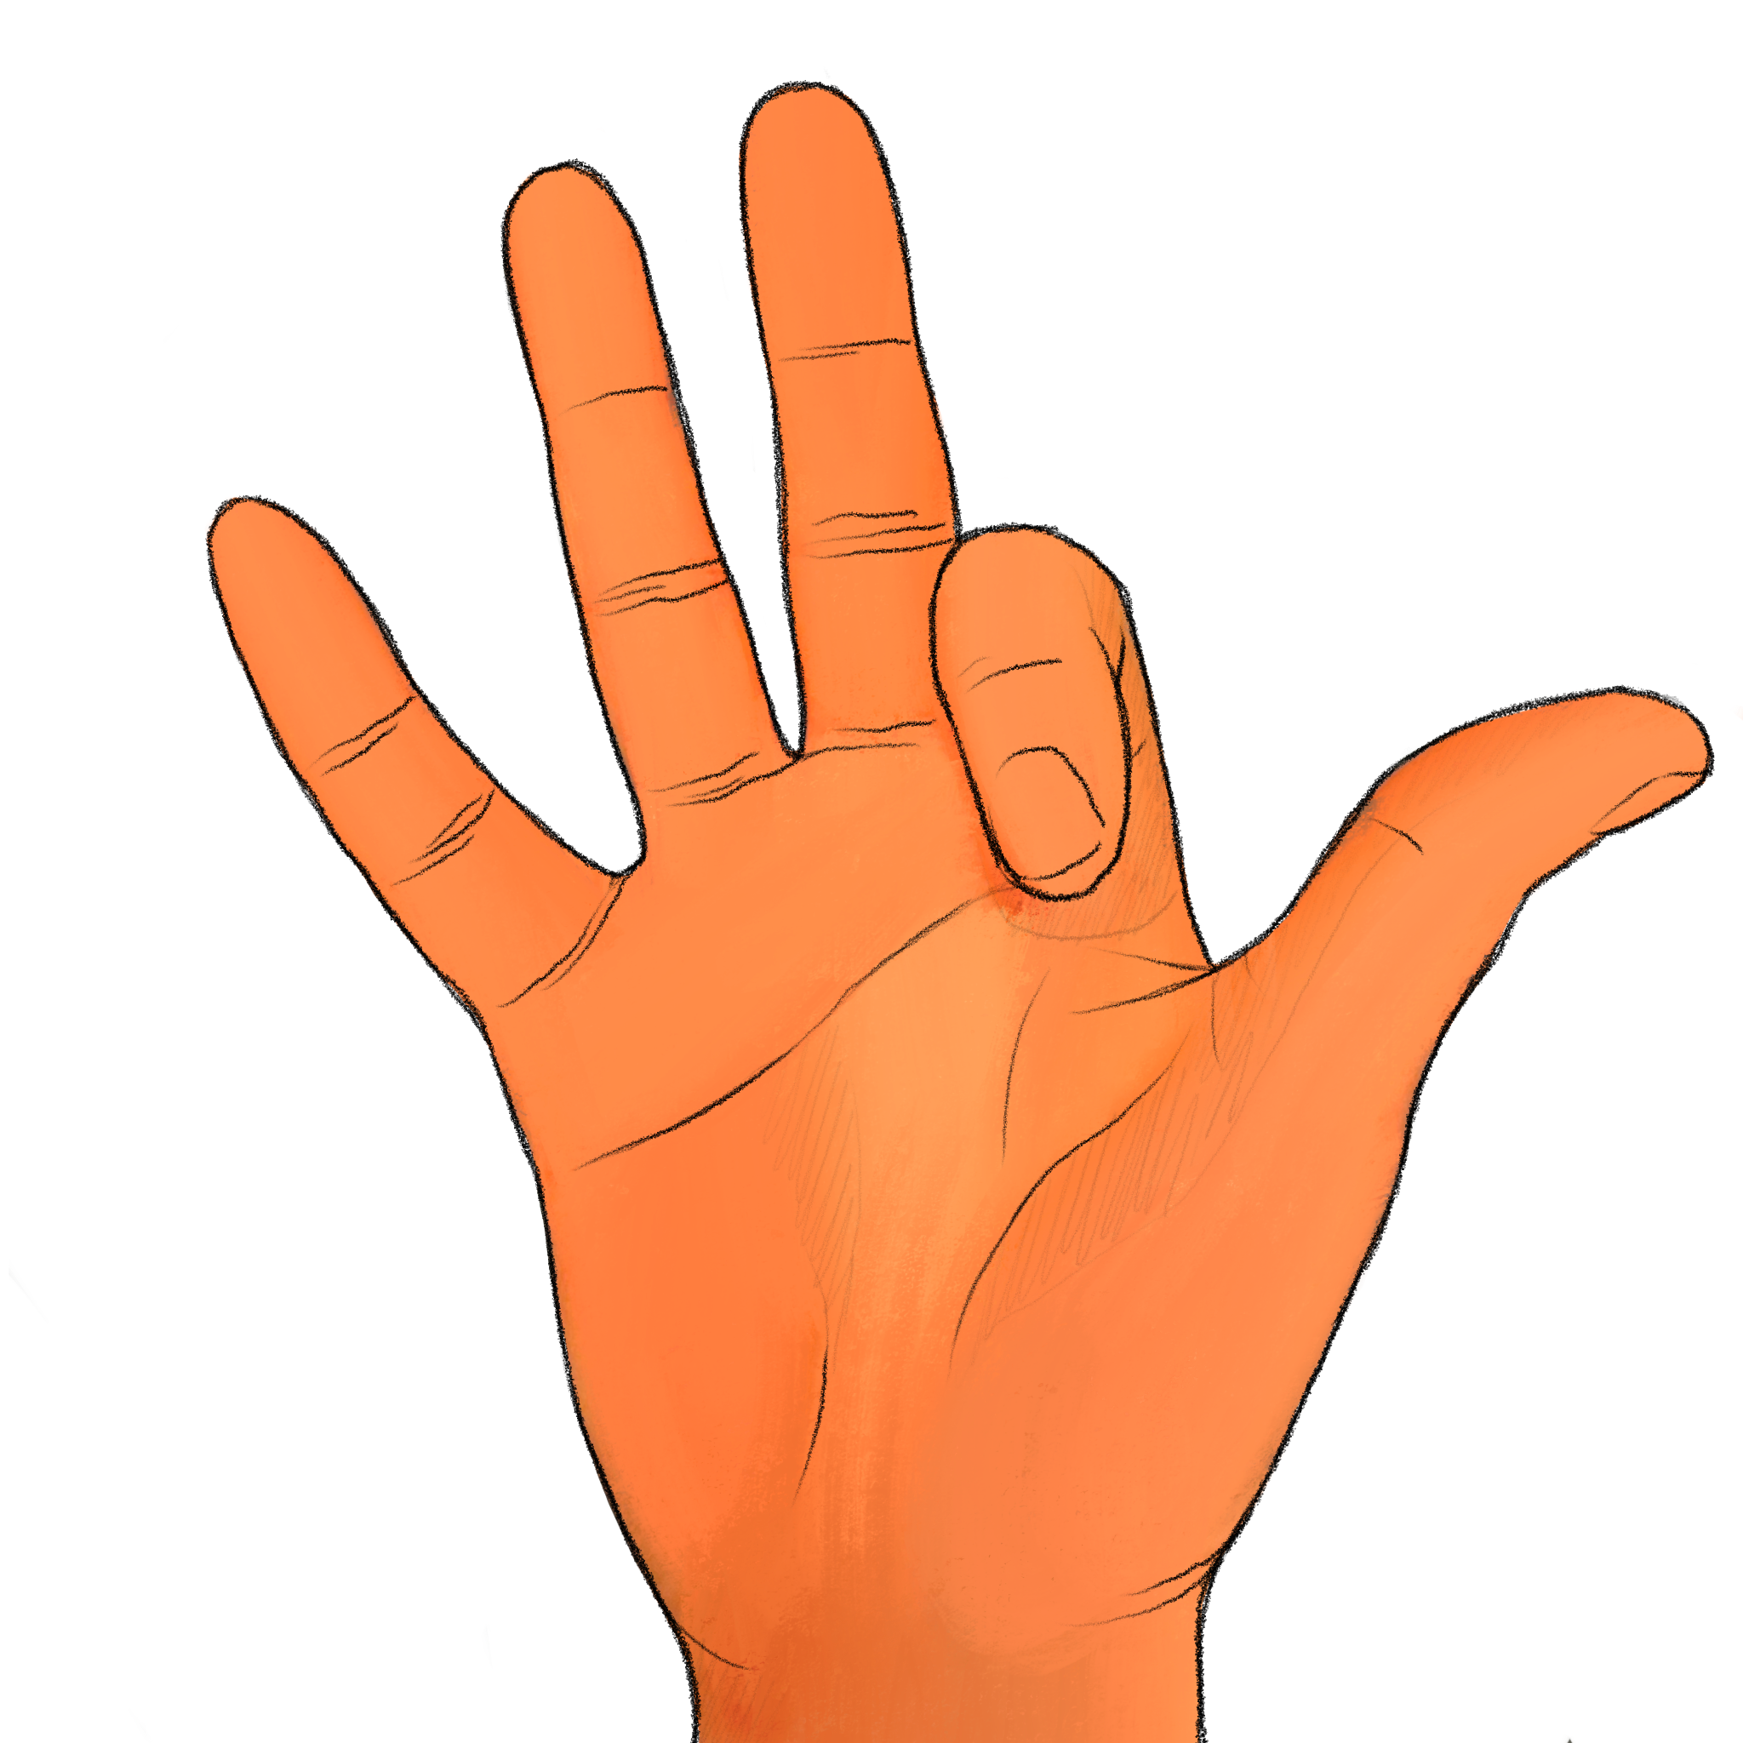
+

Slide 24
How many digits were raised? Experimenter, record the participant’s response if given before next slide transition; otherwise record a ’timeout’

Slide 25
Trial 7 Press any key to continue.

Slide 26
+

Slide 27
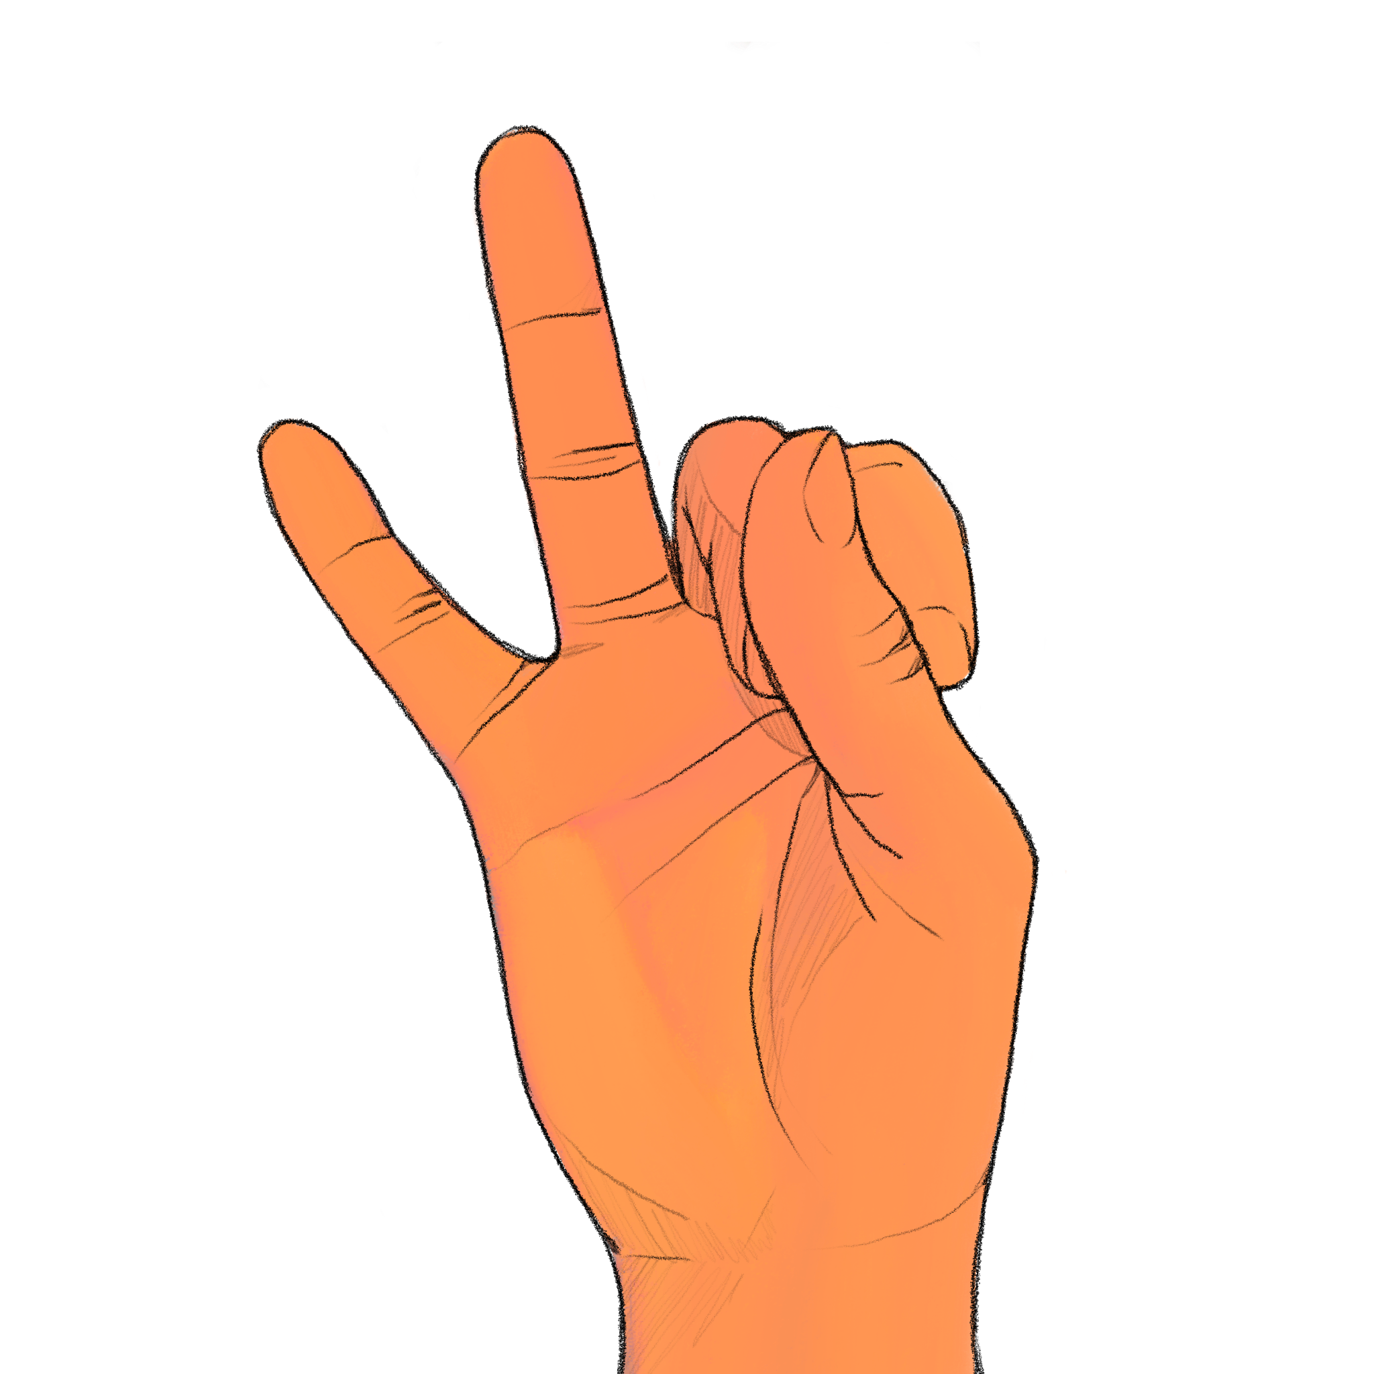
+

Slide 28
How many digits were raised? Experimenter, record the participant’s response if given before next slide transition; otherwise record a ’timeout’

Slide 29
Trial 8 Press any key to continue.

Slide 30
+

Slide 31
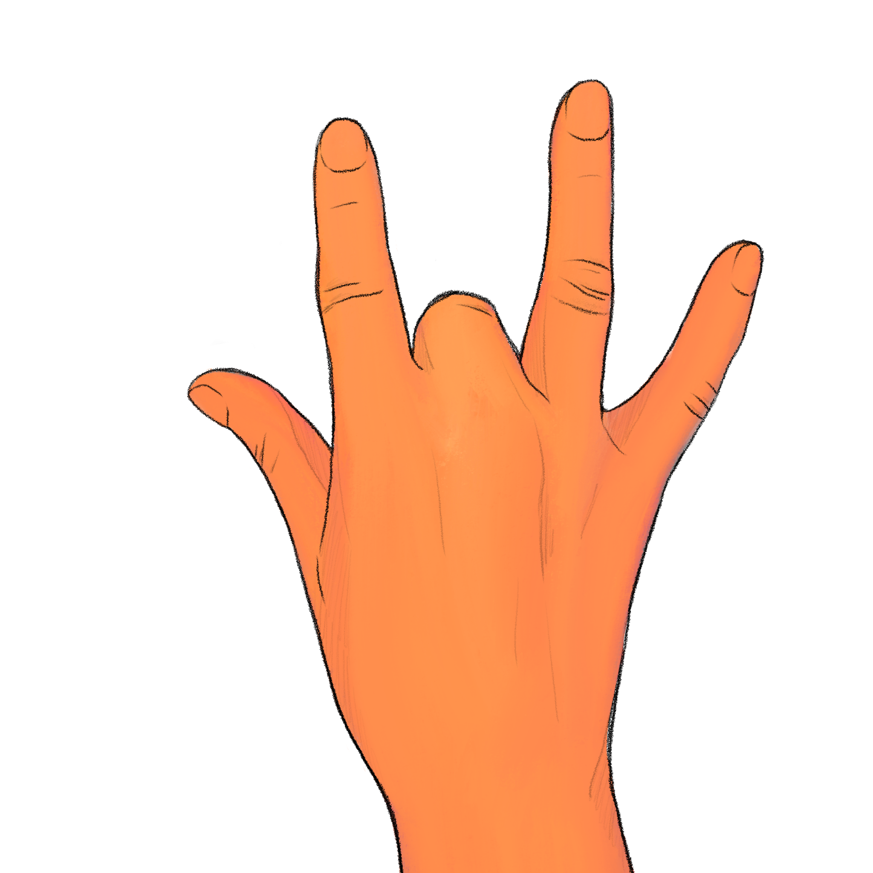
+

Slide 32
How many digits were raised? Experimenter, record the participant’s response if given before next slide transition; otherwise record a ’timeout’

Slide 33
Trial 9 Press any key to continue.

Slide 34
+

Slide 35
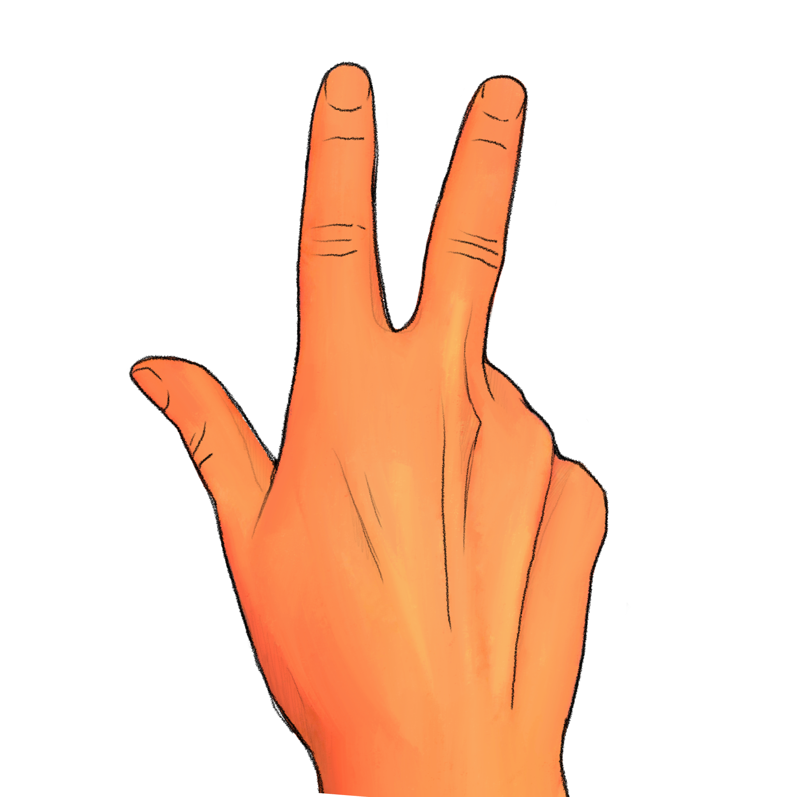
+

Slide 36
How many digits were raised? Experimenter, record the participant’s response if given before next slide transition; otherwise record a ’timeout’

Slide 37
Trial 10 Press any key to continue.

Slide 38
+

Slide 39
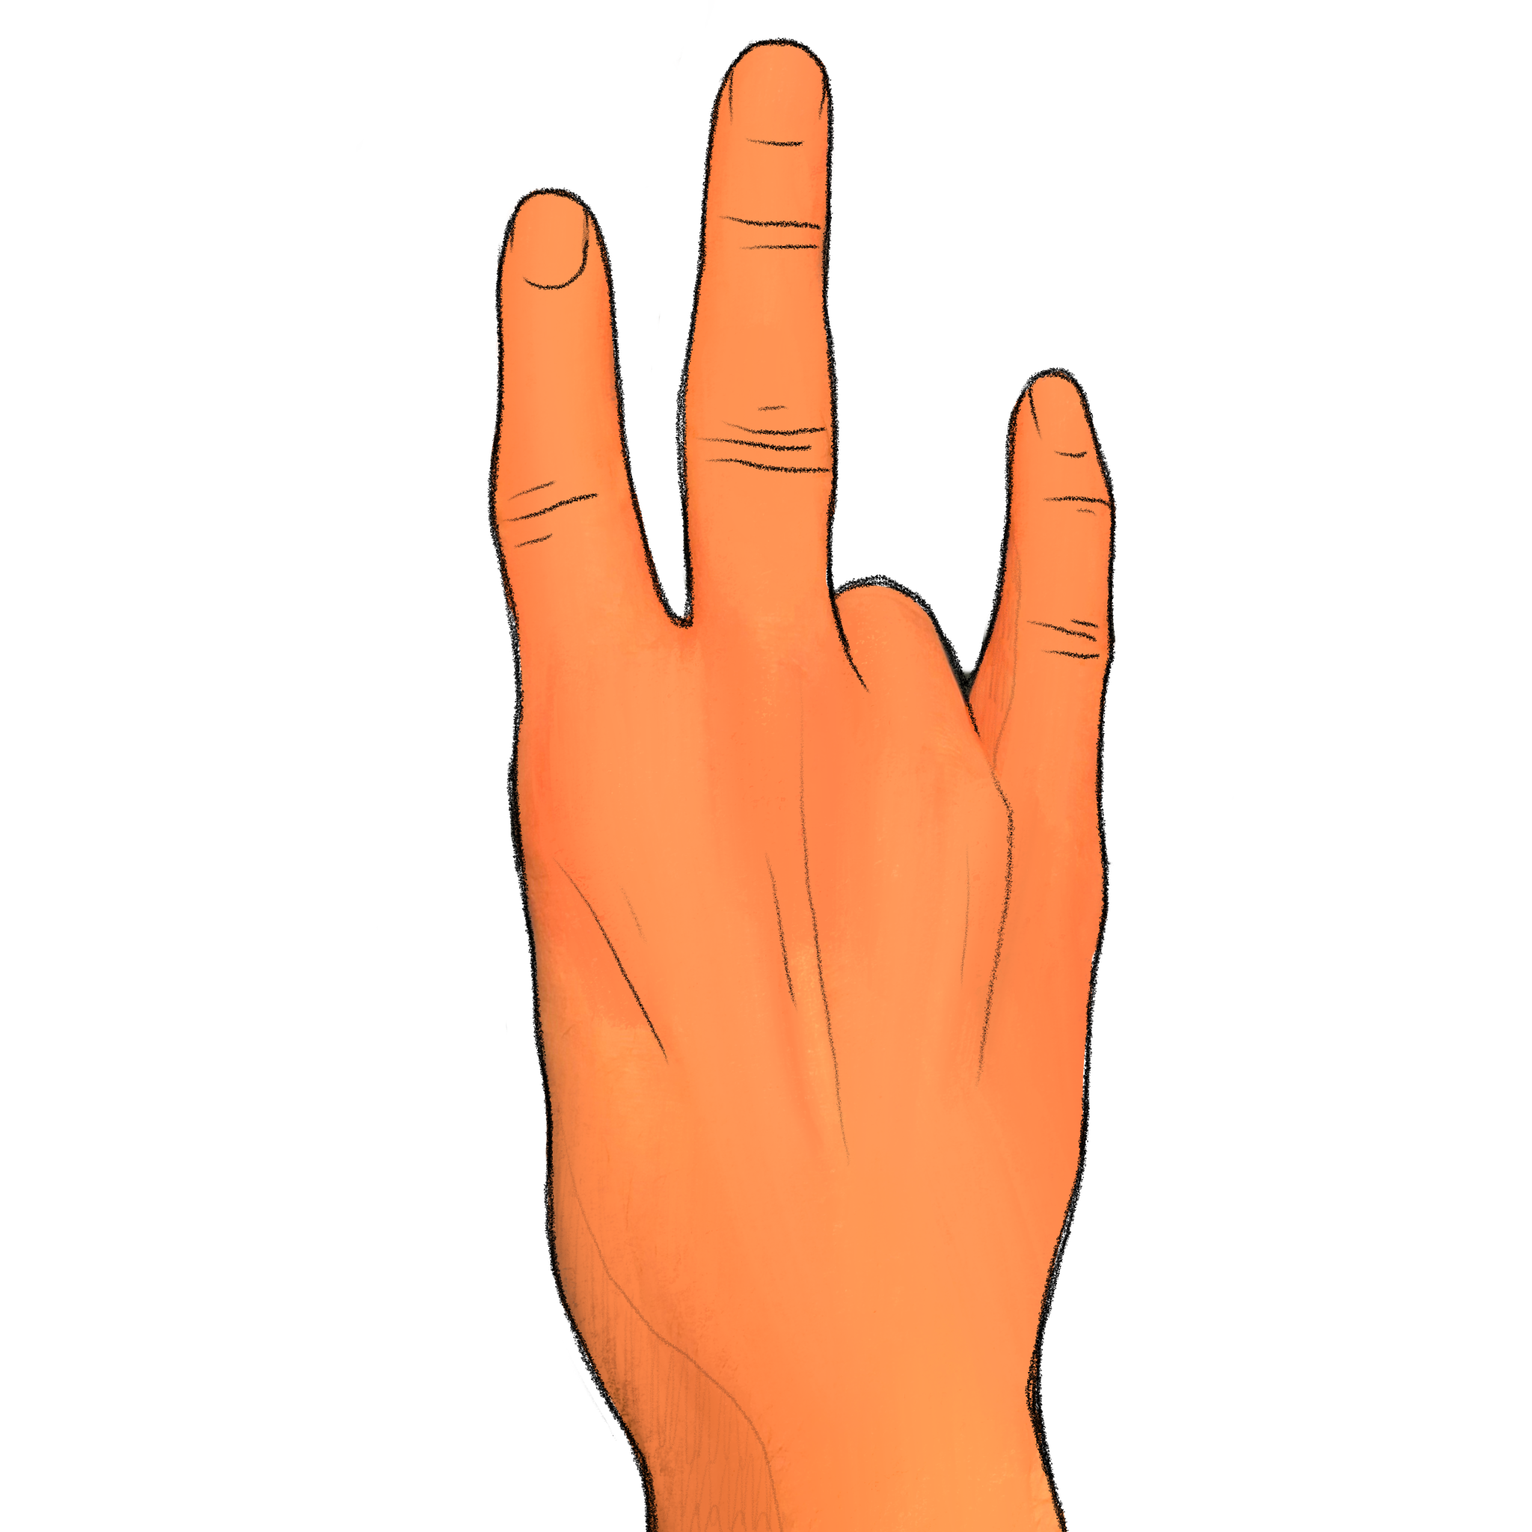
+

Slide 40
How many digits were raised? Experimenter, record the participant’s response if given before next slide transition; otherwise record a ’timeout’

Slide 41
Trial 11 Press any key to continue.

Slide 42
+

Slide 43
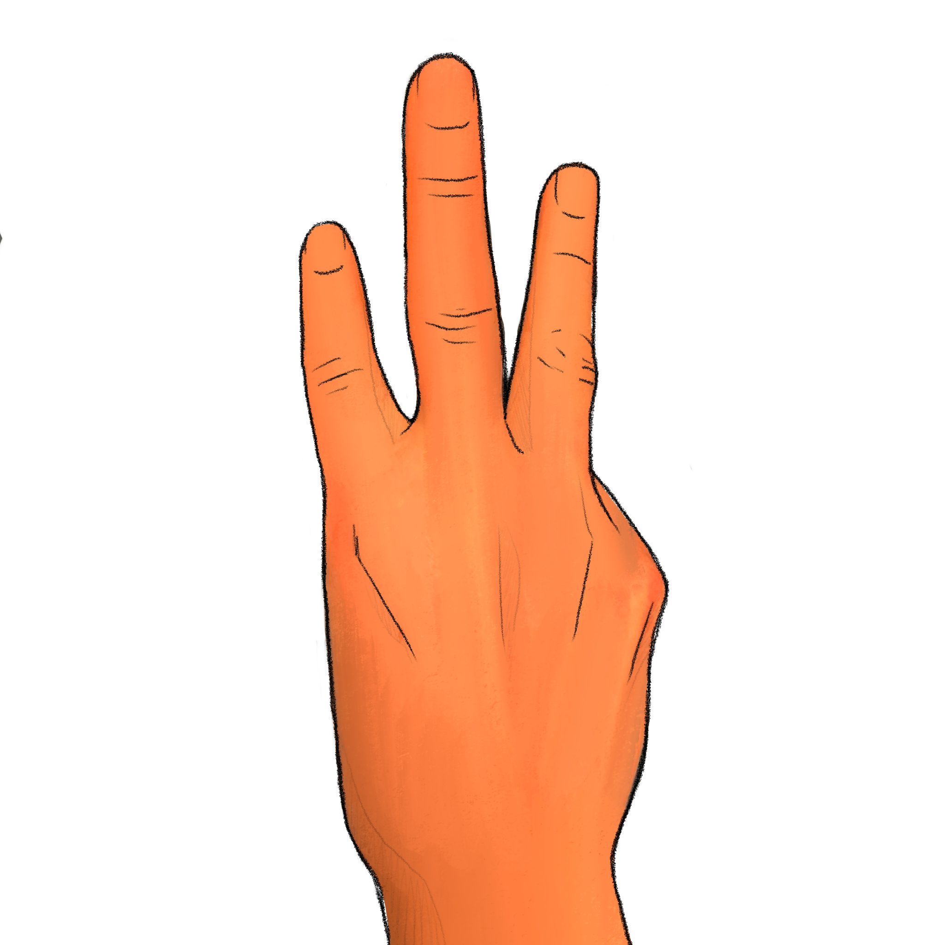
+

Slide 44
How many digits were raised? Experimenter, record the participant’s response if given before next slide transition; otherwise record a ’timeout’

Slide 45
Trial 12 Press any key to continue.

Slide 46
+

Slide 47
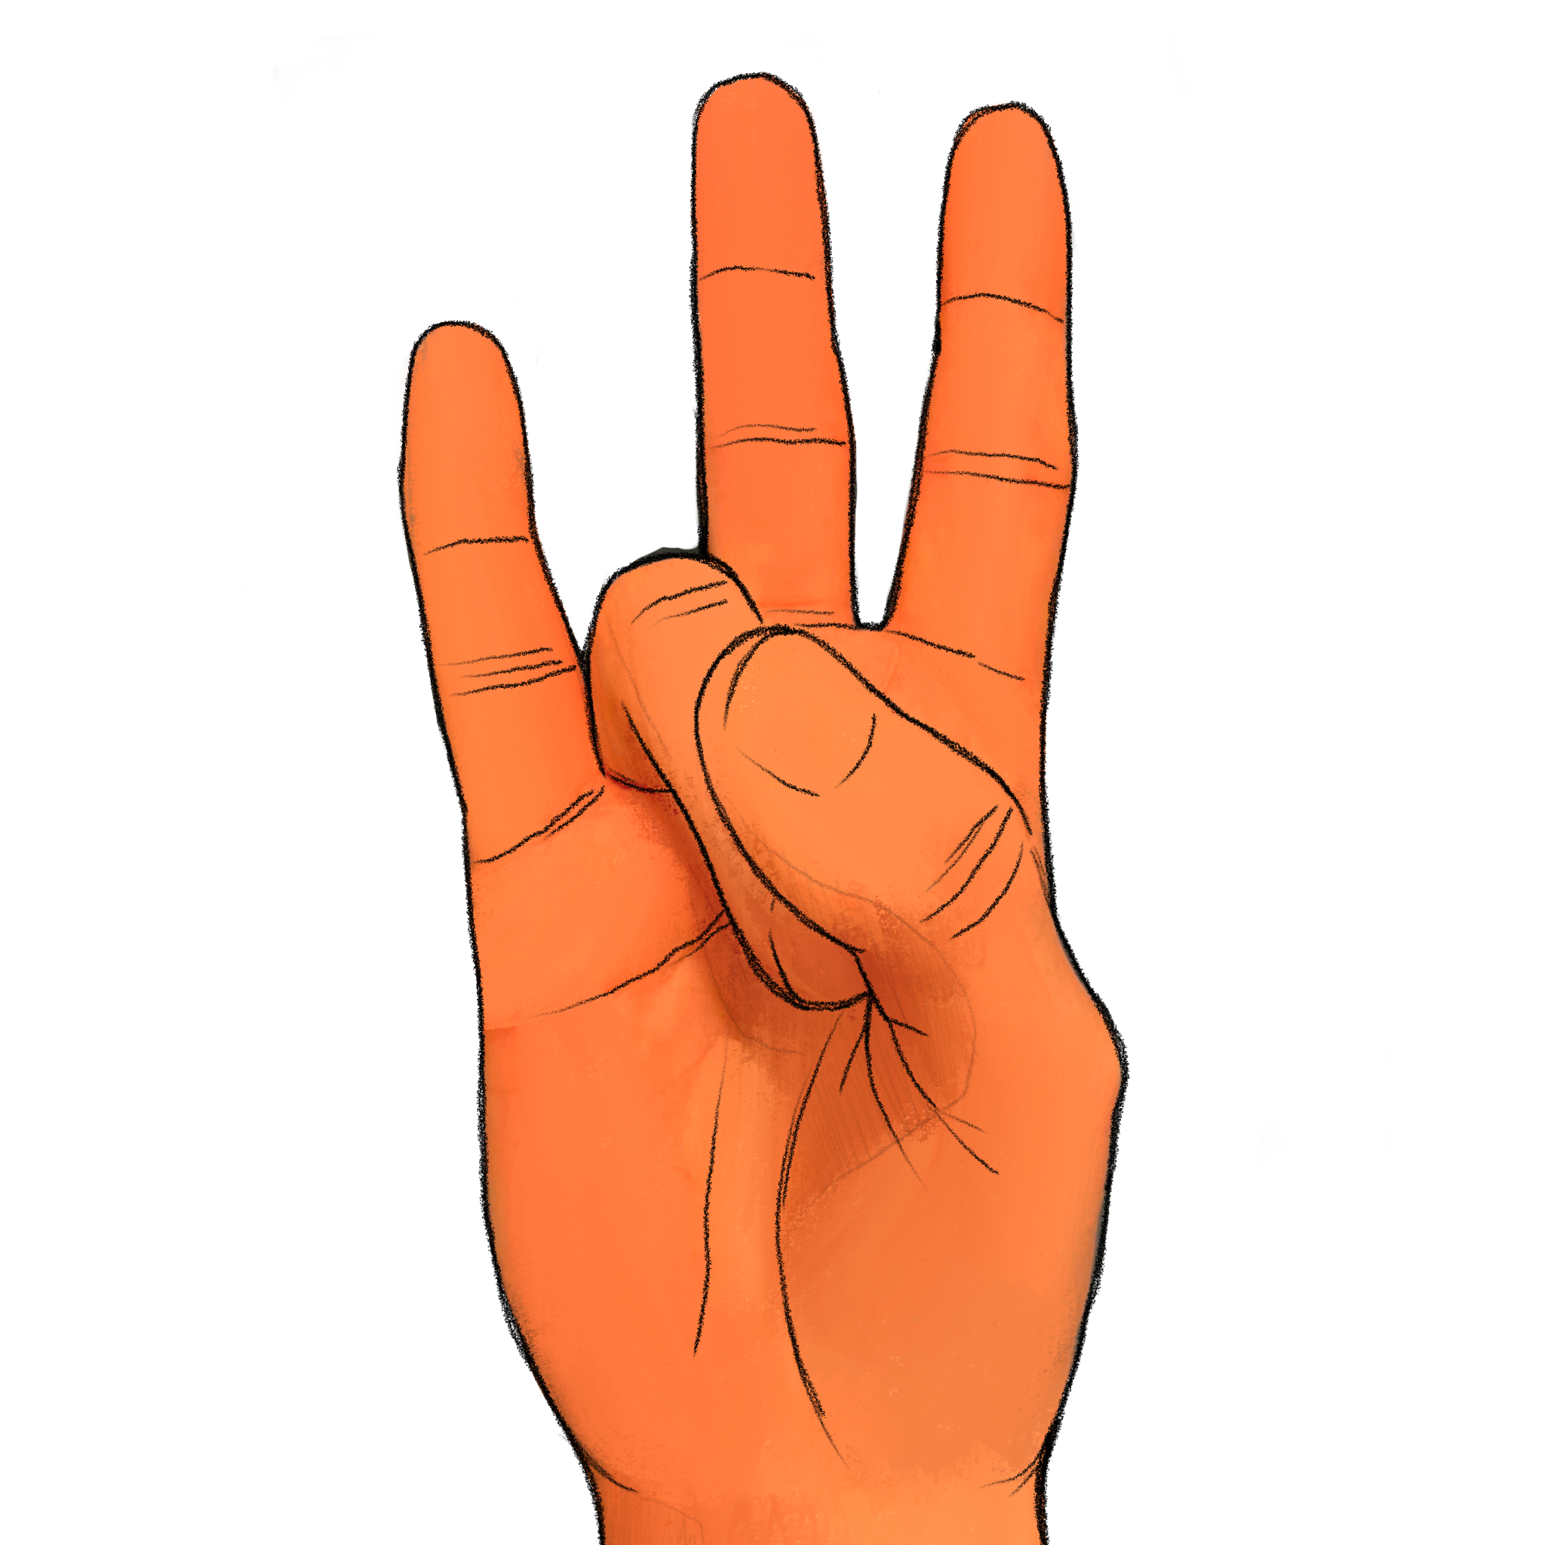
+

Slide 48
How many digits were raised? Experimenter, record the participant’s response if given before next slide transition; otherwise record a ’timeout’

Slide 49
Trial 13 Press any key to continue.

Slide 50
+

Slide 51
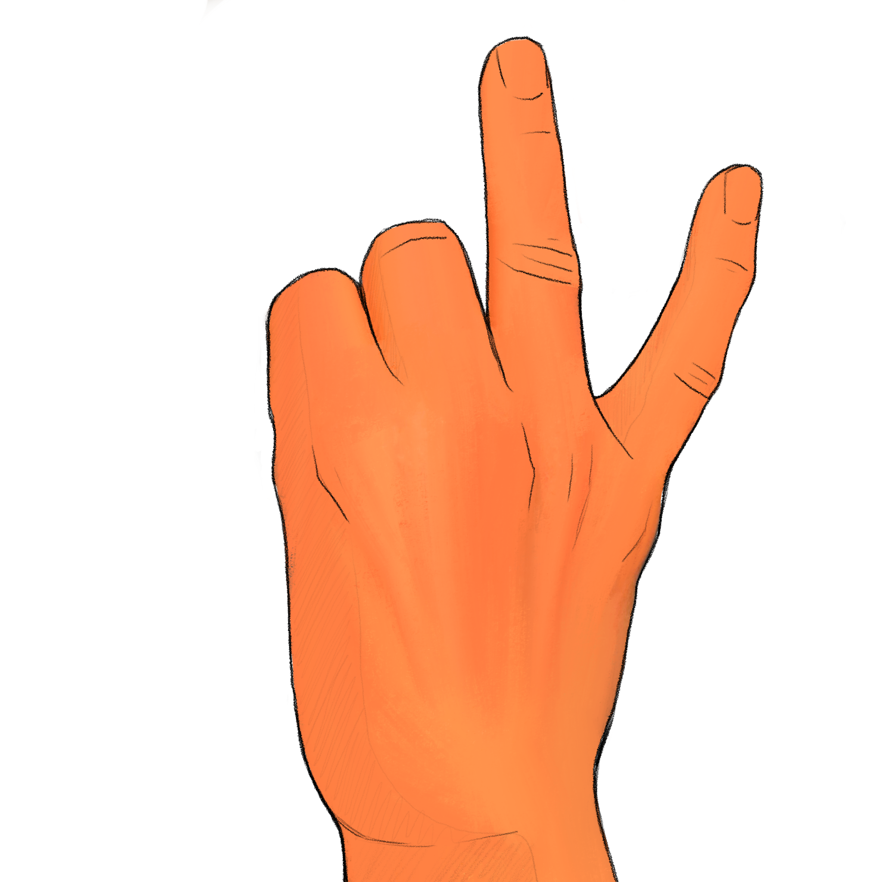
+

Slide 52
How many digits were raised? Experimenter, record the participant’s response if given before next slide transition; otherwise record a ’timeout’

Slide 53
Trial 14 Press any key to continue.

Slide 54
+

Slide 55
+

Slide 56
How many digits were raised? Experimenter, record the participant’s response if given before next slide transition; otherwise record a ’timeout’

Slide 57
Trial 15 Press any key to continue.

Slide 58
+

Slide 59
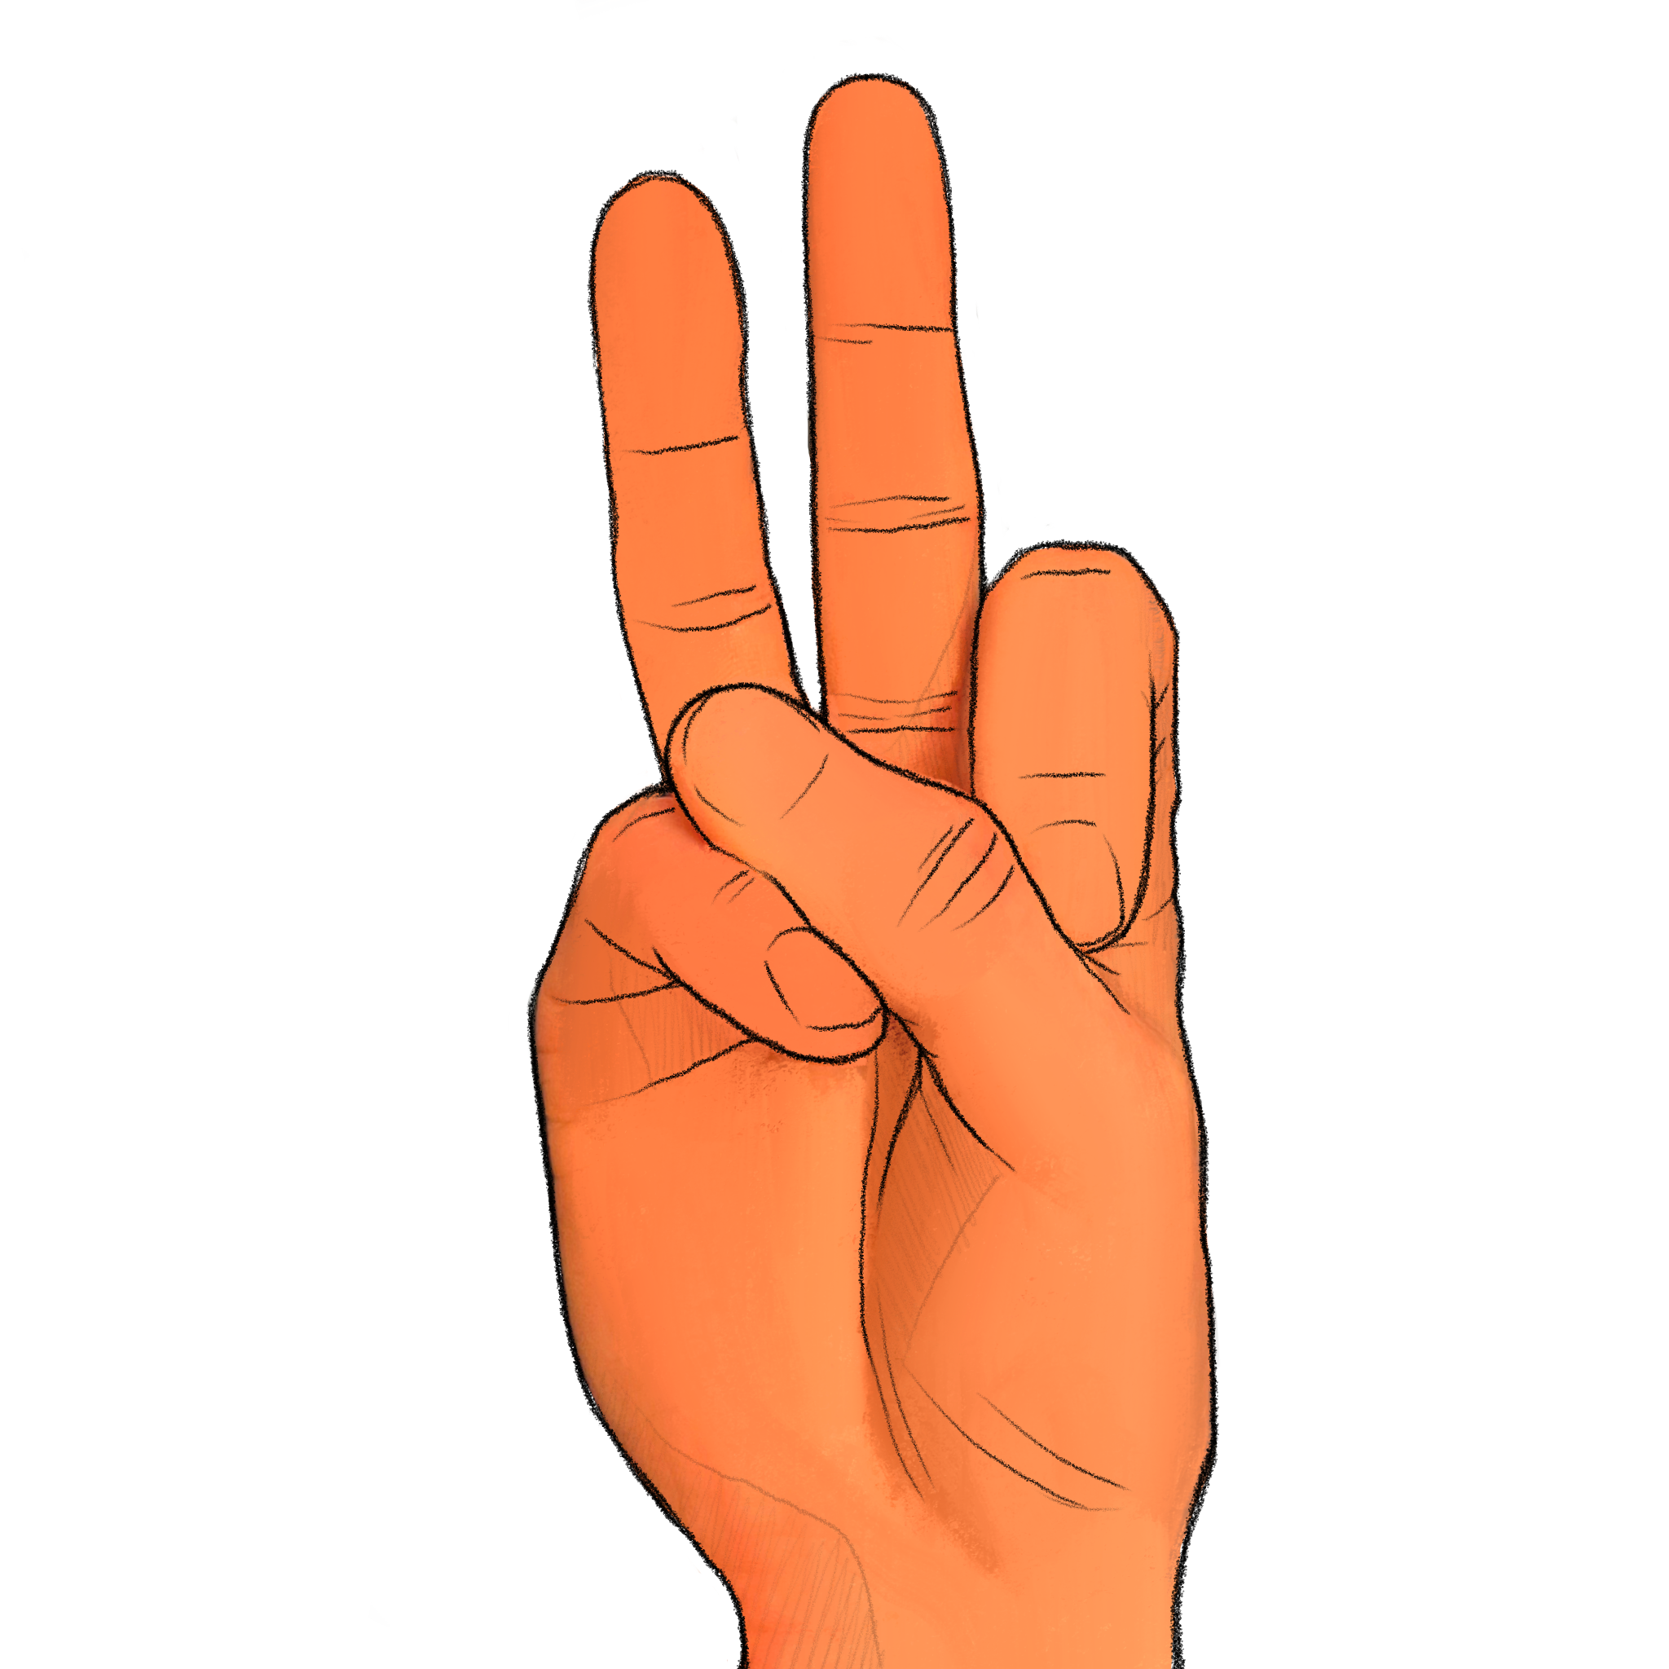
+

Slide 60
How many digits were raised? Experimenter, record the participant’s response if given before next slide transition; otherwise record a ’timeout’

Slide 61
Trial 16 Press any key to continue.

Slide 62
+

Slide 63
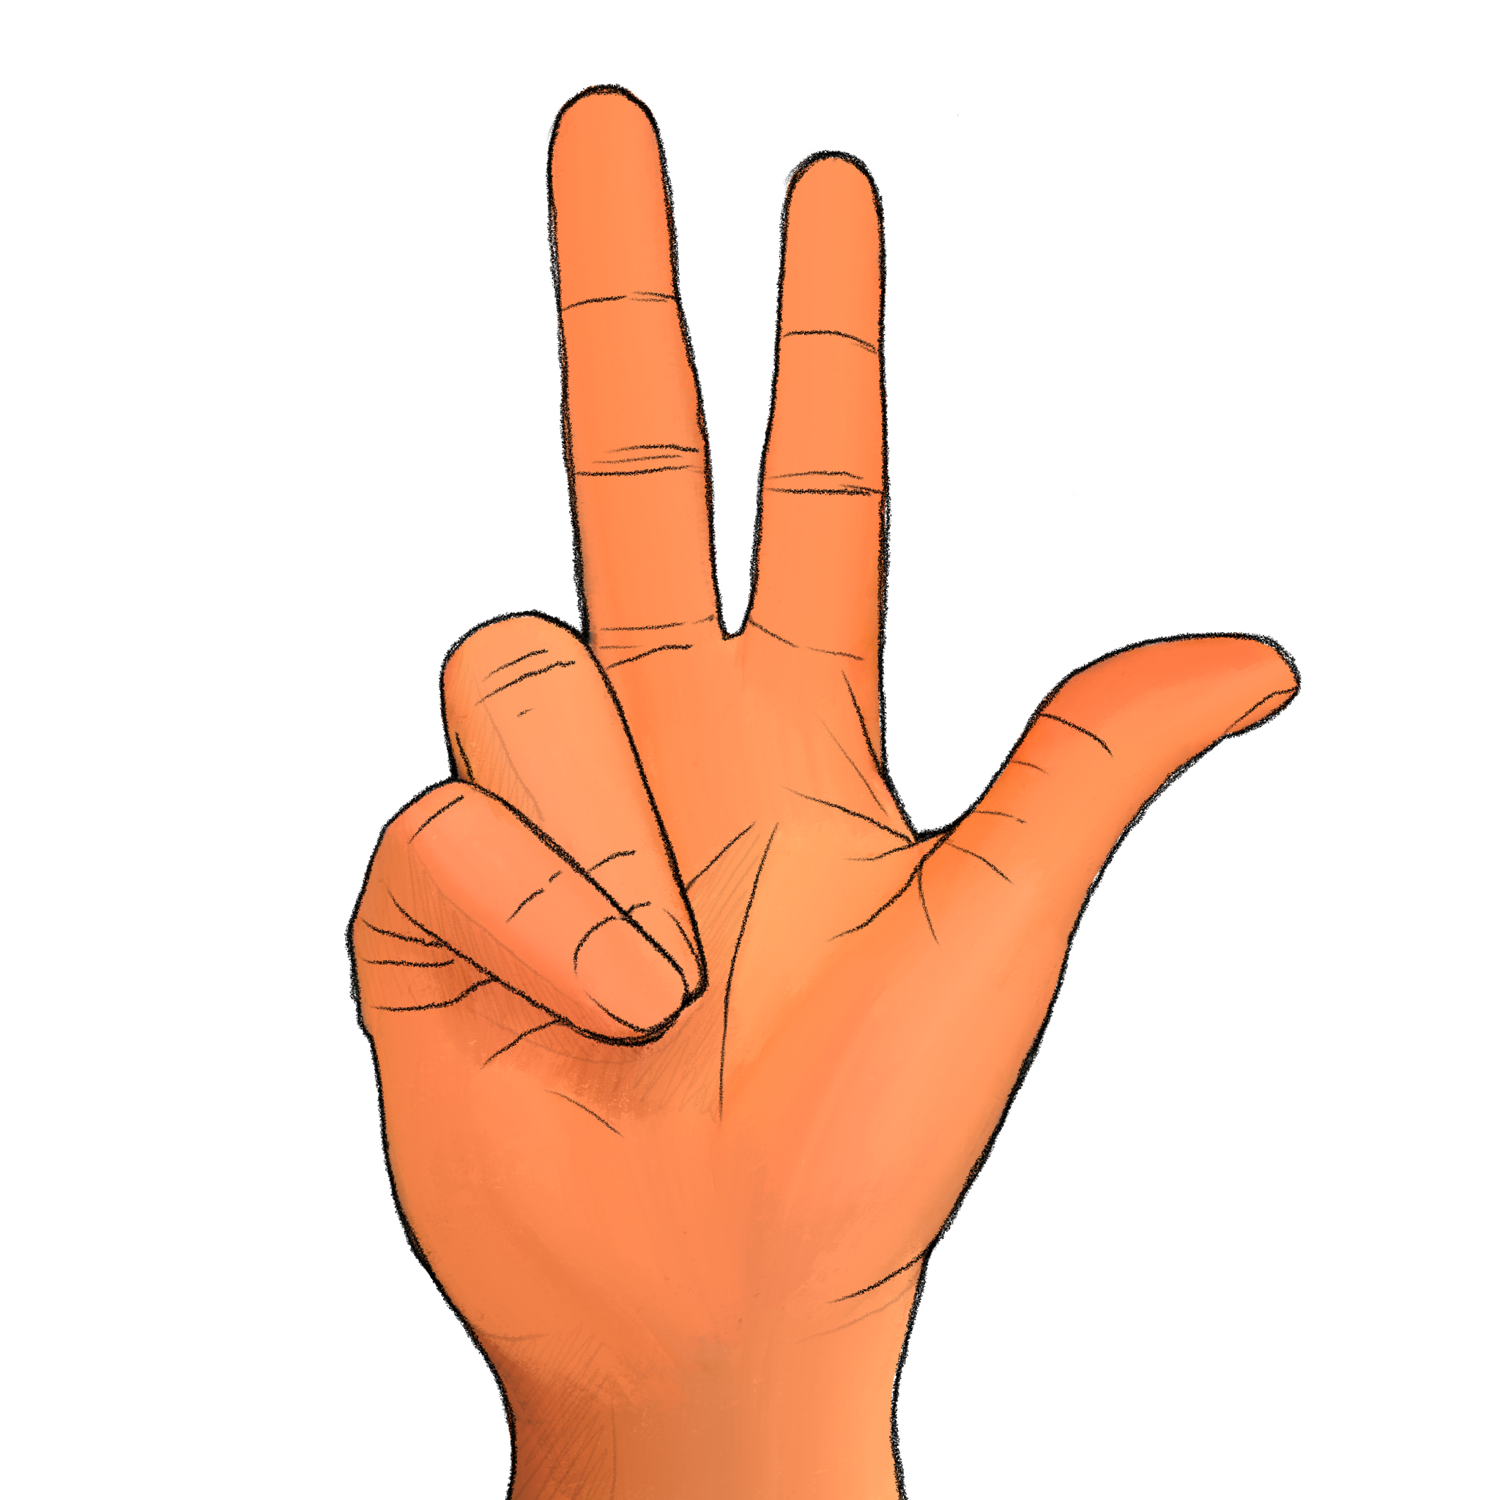
+

Slide 64
How many digits were raised? Experimenter, record the participant’s response if given before next slide transition; otherwise record a ’timeout’

Slide 65
Trial 17 Press any key to continue.

Slide 66
+

Slide 67
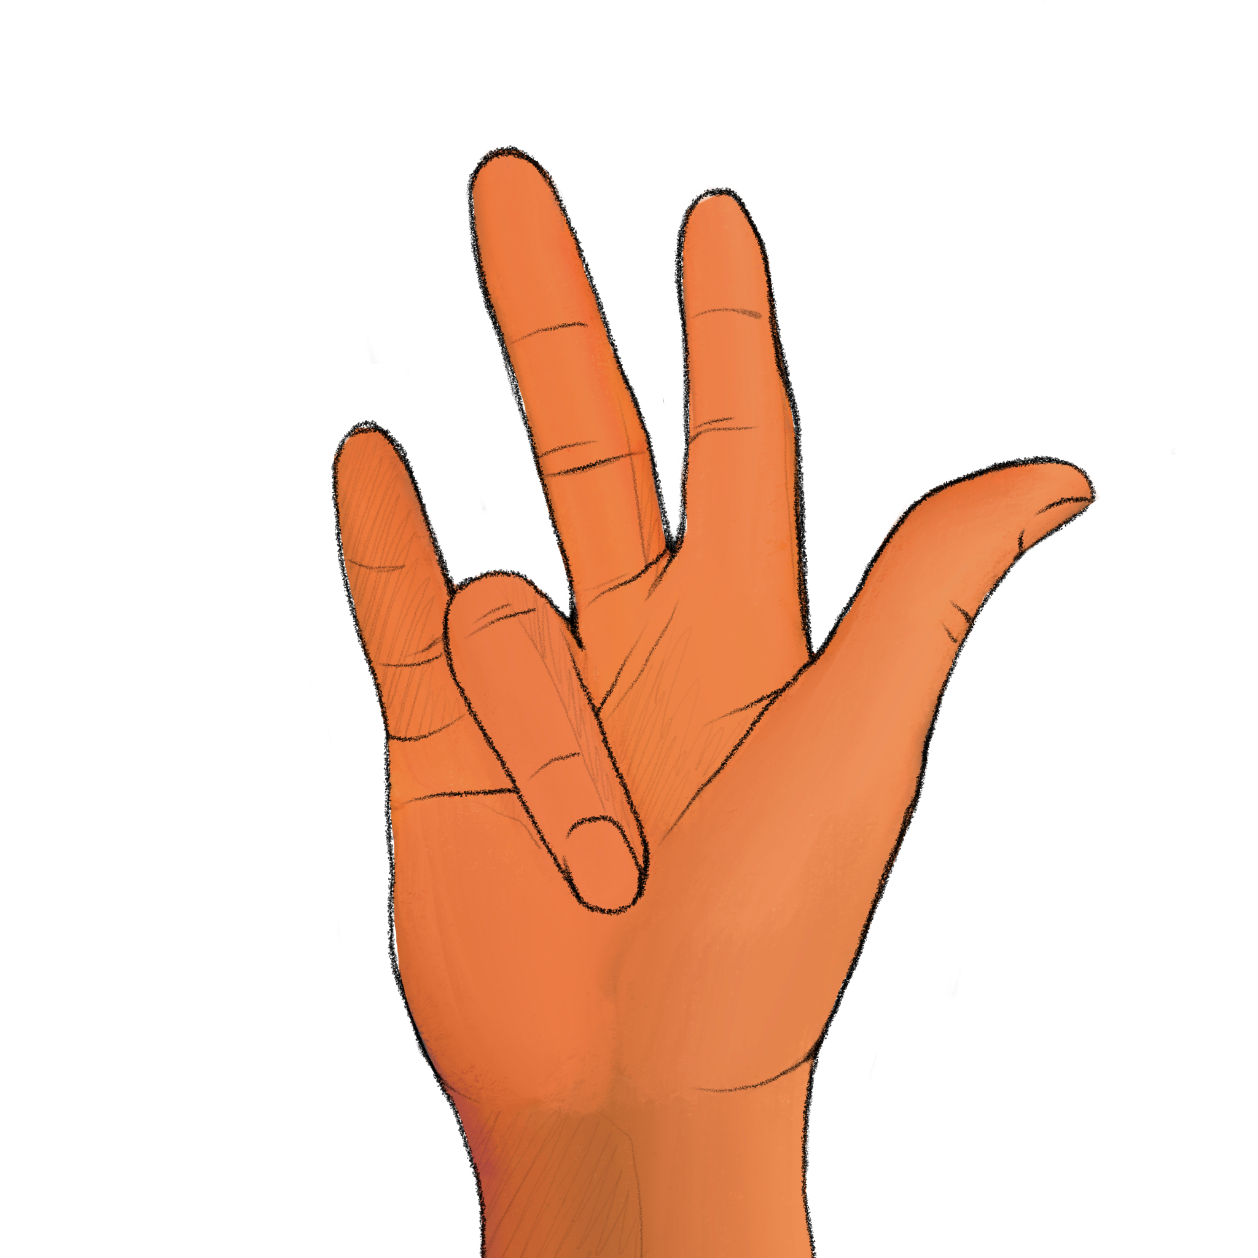
+

Slide 68
How many digits were raised? Experimenter, record the participant’s response if given before next slide transition; otherwise record a ’timeout’

Slide 69
Trial 18 Press any key to continue.

Slide 70
+

Slide 71
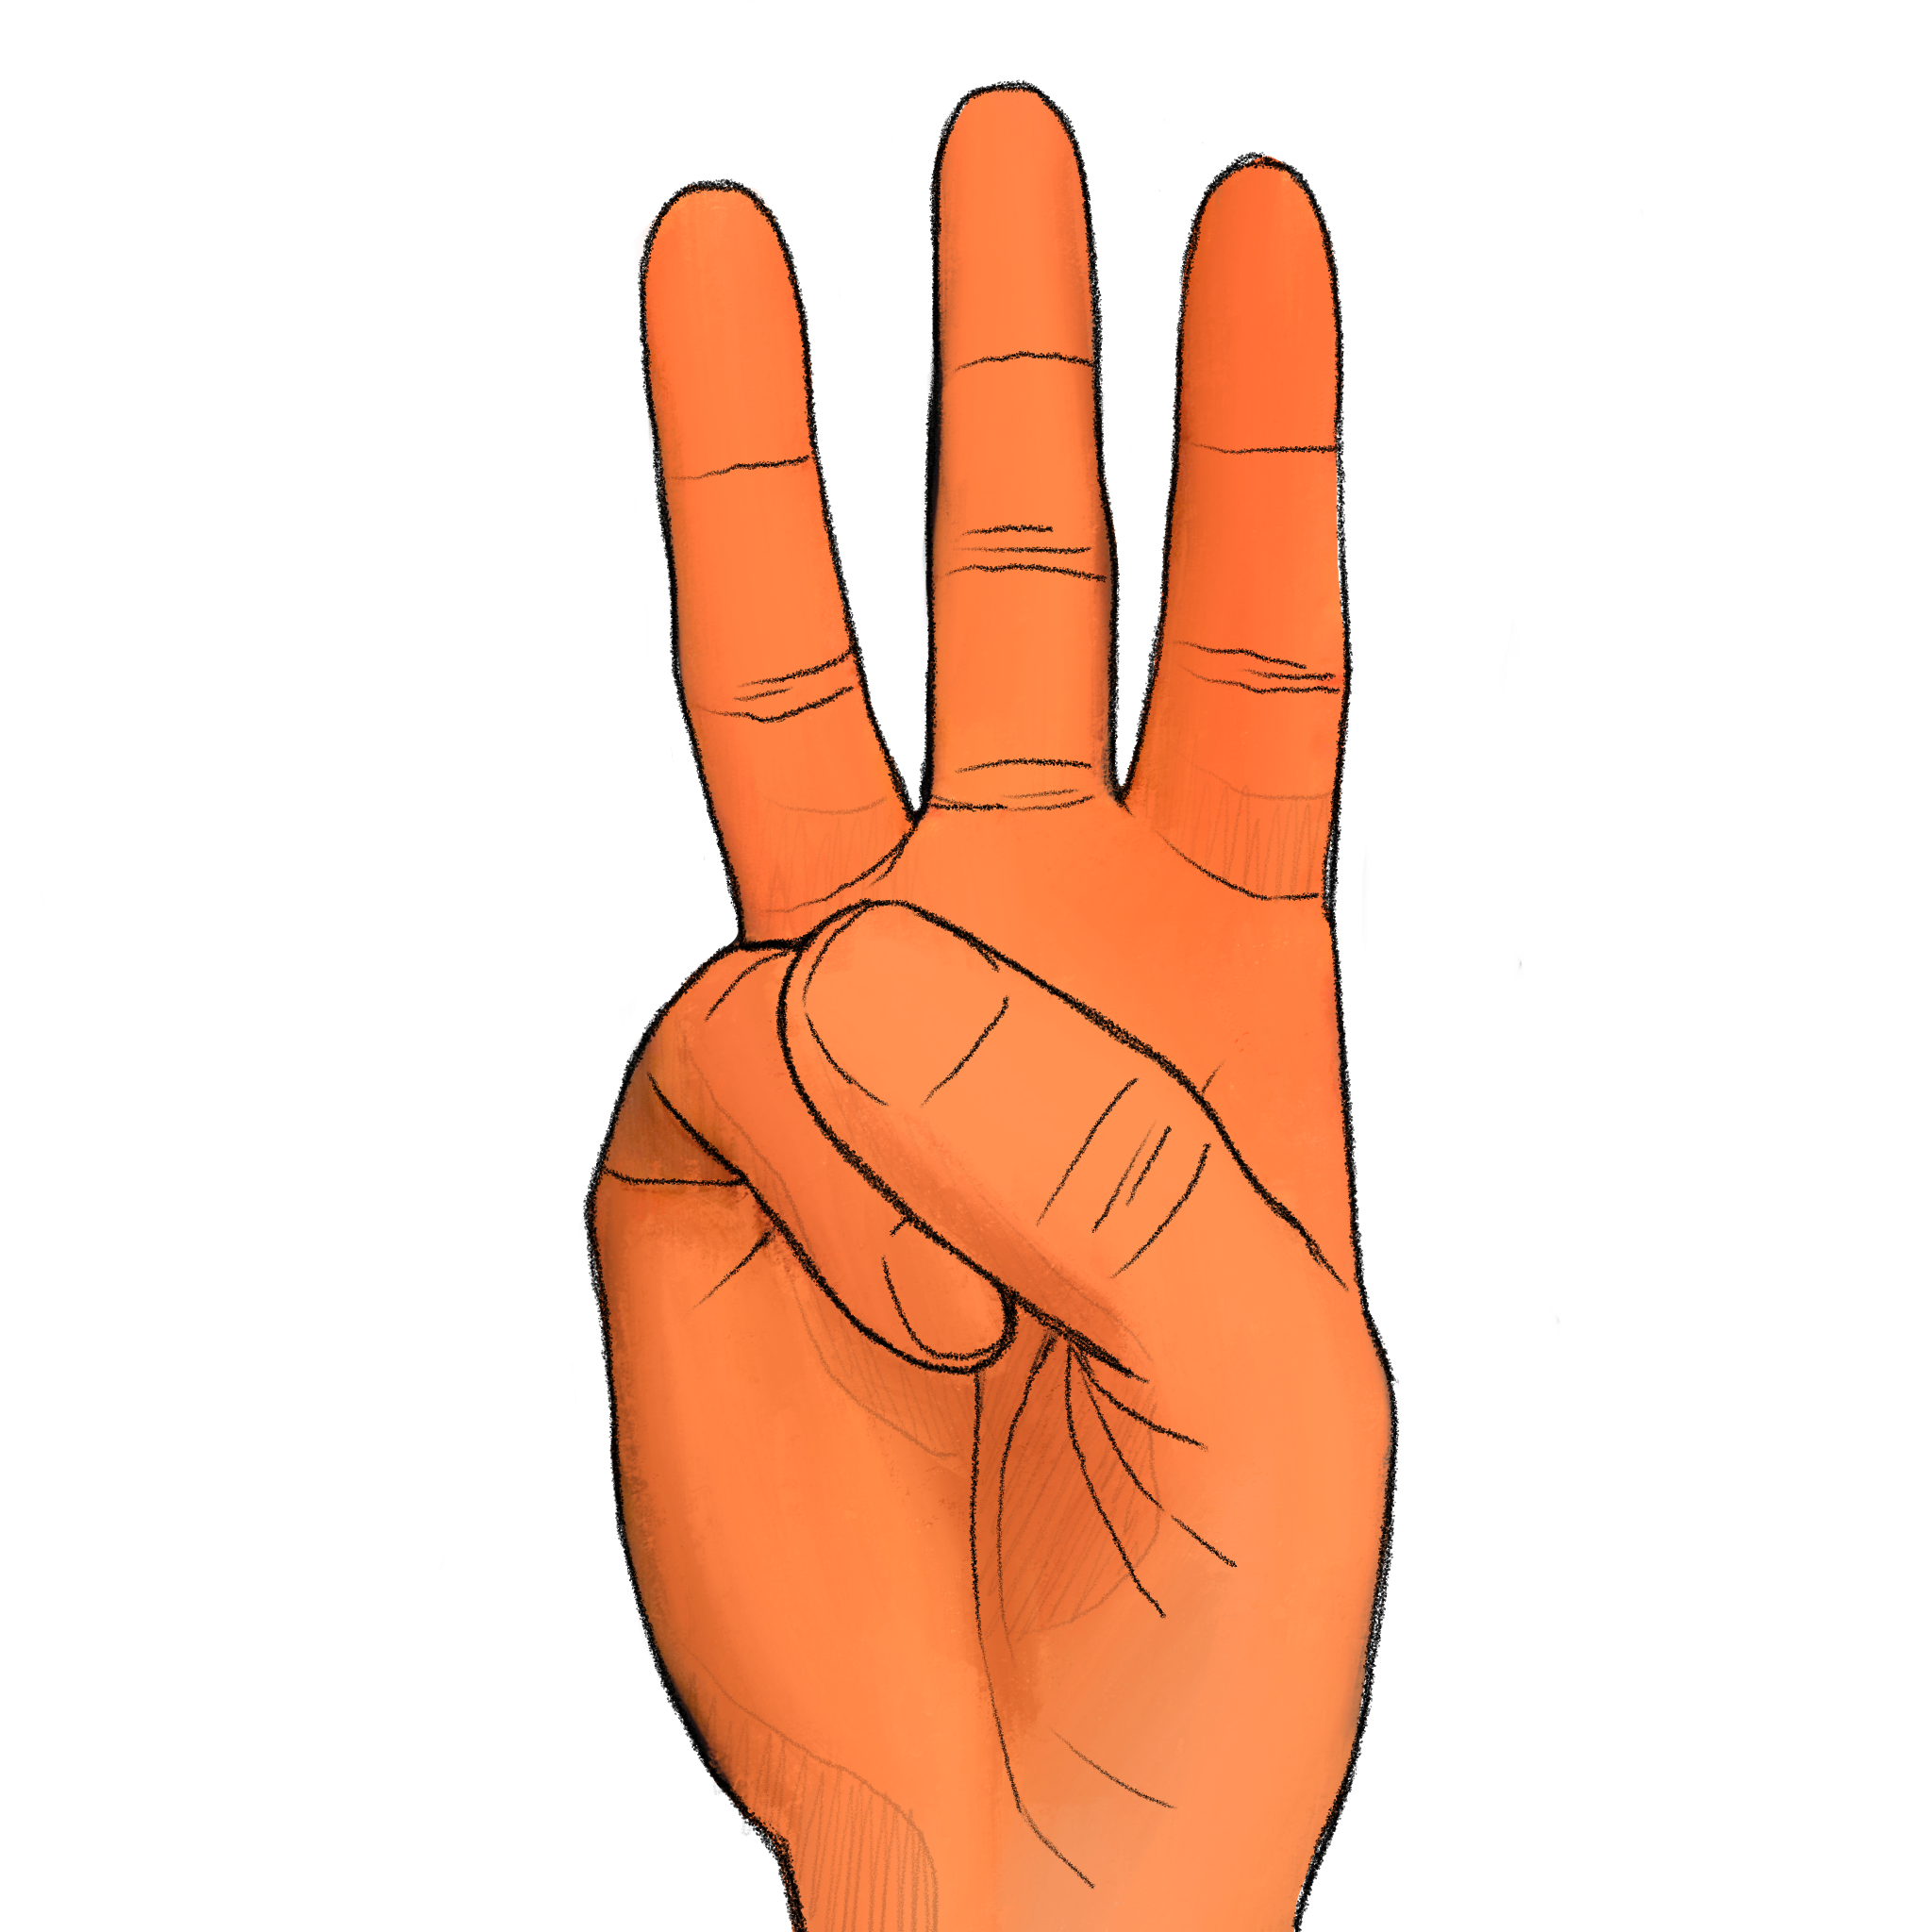
+

Slide 72
How many digits were raised? Experimenter, record the participant’s response if given before next slide transition; otherwise record a ’timeout’

Slide 73
Trial 19 Press any key to continue.

Slide 74
+

Slide 75
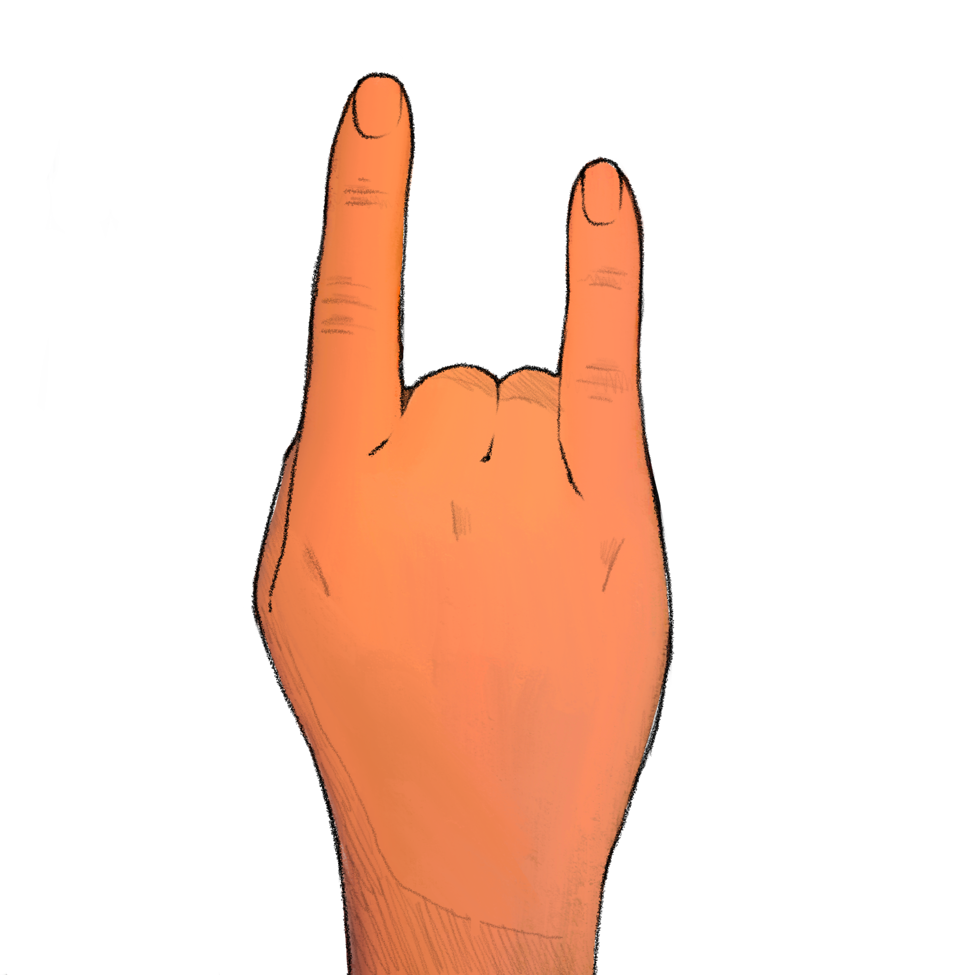
+

Slide 76
How many digits were raised? Experimenter, record the participant’s response if given before next slide transition; otherwise record a ’timeout’

Slide 77
Trial 20 Press any key to continue.

Slide 78
+

Slide 79



